Slide 1
GTS TI&A Storage Strategy Solution Guidance 2Q 2018 Globally Approved IBM Internal Use Only
Global Storage TI&A Jim Olson & Global DA/ACB team May 2018
URL -> http://ibm.biz/BdrAQ9
Education -> https://w3-connections.ibm.com/wikis/home?lang=en-us#!/wiki/Wbe059189a772_432c_beb2_4ee099a7f9c9/page/Global%20SLE%20Storage%20-%20Strategy

Slide 2
The GTS TI&A Storage Solution Strategy deck is a guide for designing storage infrastructure based on years of real world experience. The guidance often differs from marketing material which is generated in labs tuned to maximize benchmark performance. Following the guidance will result in a design which balances risk and cost for general purpose workloads. The guidance is not intended to replace careful engineering, you must ensure that the configuration is capable of satisfying the customer’s requirements.
Our strategy is based on rigid designs, ‘hard to do harm’ designs, and as such, we try hard to limit configurations. This in no way should negatively reflect on a given piece of technology, rather should be looked at more broadly. There are valid use cases for technology not in our strategy that may be justifiable for use. If deviations of strategy/best practices our sought, find us here under ‘Ask a technical question’ - https://w3-connections.ibm.com/communities/service/html/communitystart?communityUuid=ee2222e8-6a33-4f67-9c79-79e45bc8db5b
Configurations herein are presented as guidance only and are not a substitute for actual solution design. (*Note: Exercise caution with GAR’s purchases - As a general rule devices that are End of Marketing/End of Sale will have limited useful life and should not be purchased.) If you see a business need to divert from this strategy please come to us to assist in your solution development.
Reminder on strategy: Follow all GTS best practices, use local HA for mission critical applications, use Disaster Recovery replication (DRaaS) for all production data and ensure backup resiliency via Backup aaS. Orchestration for DR should be included so that you can use it for a non-disaster event (storage device down, etc.)
Reminder that all of our documentation is in GDA+ and you should use regularly. See last slide in deck.

Slide 3
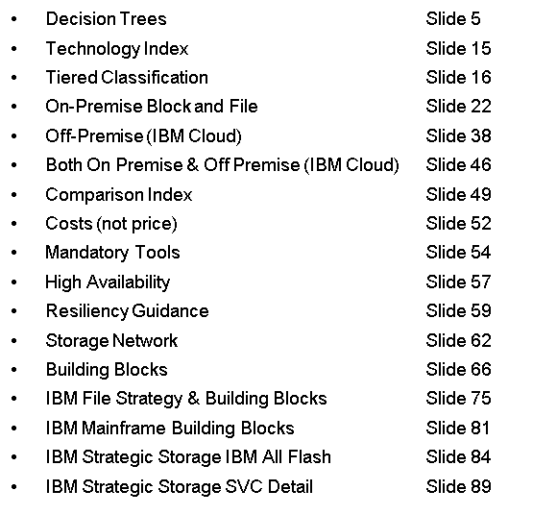
2018 Update
Go To Slide # by Topic
This Storage Strategy deck has been restructured, now providing a focus on the decision trees, (to assist you more quickly in your solution choices), key strategic technologies, and offerings. We have placed the building blocks/tiered storage guidance, and detail descriptions further down in the deck.
For a 2017 update on SDS Strategy and how it fits into the bigger SDE picture see here - Link
Storage Location
With the advent of Cloud-based Storage, Storage can be in a traditional “On Premise” location or “Off Premise” in a Cloud. There are some pros and cons to each. The following slides attempt to help you decide.
These decision trees attempt to guide you to the optimum storage solution based on GTS approved and tested best practices.
Other storage solutions are considered exceptions and should be reviewed for approval via the GTS Storage Domain.
Overall Key Storage Strategic Direction
Our primary strategy is to use the IBM Cloud Private Storage Offering in as many solutions as possible.
We are moving away from virtualized storage unless it is a client requirement (No SVC)
We are exploiting the A9000 Pod instead of spinning disk and employing QOS when needed
Move non-mission critical workloads/storage to IBM Cloud
Implement a Disaster Recovery solution with replication to IBM Cloud
We use deduplication and compression heavily in our strategy to achieve target costs (per GB). Please see slide later in this deck for details and be sure you ask about this during sizing. Host or infight encryption or compression can adversely affect storage optimization which will substantially increase costs by eliminating storage optimization.

Slide 4
Decision Trees
GTS Global Storage Strategy
Definitions for use
‘On-Premise’ – this refers to a client Datacenter and/or a traditional enterprise IBM GTS DC
‘IBM Cloud’ – this is what has previously been referred to as Softlayer.
‘IBM Cloud Private Storage’ – this is our new storage offering only to be used on-premise.
Storage Strategy - Decision Trees

Slide 5
On Premise vs IBM Cloud Decision Tree
This decision tree aims to guide you to the appropriate landing zone for a given requirements. This is not fixed in stone but gives you some points in the right direction.
Additional guidance is available throughout the Strategy Deck.
Mission critical workloads are NOT supported on Software Defined Storage in IBM Cloud.
If 100% Cloud is mandated then use Endurance for the % of workloads which are defined as mission critical and follow GTS Storage Strategy for the rest of the workloads. Unless the applications are Cloud native/ready in which case deployment on SDS is acceptable.
See Slide 38 for more clarity on mission critical.
Storage Strategy - Decision Trees

Slide 6
On Premise – ‘Block’ Storage Decision Tree
See Block Comparison table on Slide 49. See Cost Comparison table on Slide 52.
Avoid utilising Storage Virtualisation where possible. See Slide 31. Where required, limit multi-tier SVC solutions to 2 Tiers.
Where possible GTS Strategy is to utilise IBM Cloud Private Storage Offering. See Slides 22-27.
Storage Strategy - Decision Trees - ON premISE Block

Slide 7
On Premise – ‘File’ Storage Decision Tree
See File Comparison table on Slide 50. See Cost Comparison table on Slide 52.
Where possible GTS Strategy is to utilise IBM Cloud Private Storage Offering. See Slides 22-27.
Storage Strategy - Decision Trees - ON PremISE File

Slide 8
On Premise – ‘Storage Fabric’ Decision Tree
See Slide 61 – 62 for contact details
Storage Strategy - Decision Trees - on premise - storage fabric

Slide 9
IBM Cloud – ‘Block’ Storage Decision Tree
See Block Comparison table on Slide 49. See Cost Comparison table on Slide 52.
Storage Strategy - Decision Trees - Ibm cloud block

Slide 10
IBM Cloud – ‘Block’ Decision Tree – VMware vSAN
All Flash vSAN Standard Configuration (for all new deployments) All Flash vSAN RAID 5 with Dedupe/Compression – will provide approximately 17k IOPs per Disk Group, with approximately 135k IOPs per 4 node Cluster with an average price of $0.04 to $0.08 per GB per month
All Flash vSAN RAID 1 with Dedupe/Compression (option for all new deployments) – will provide approximately 22k IOPs per Disk Group, with approximately 179k IOPs per 4 node Cluster with an average price of $0.12 per GB per month
All Flash vSAN RAID 6 with Dedupe/Compression (option for all new deployments) – will provide approximately 17k IOPs per Disk Group, with approximately 135k IOPs per 4 node Cluster with an average price of $0.09 per GB per month
vSAN with Intel Optane SSDs is an Option for High Performance Requirements. This can increase performance (throughput/IOPs) by between 15%-35% and decrease latency by between 10%-25%. *Although due to the small size of the Optane SSDs they are not a good fit for solutions with high write % / sequential workloads.
Further configurations are available within vSAN but are not recommended as per these best practices. Usage of any configuration without Dedupe/Compression are not recommended due to the significant increase in cost and minimal performance benefit. Enabling vSAN Native Encryption will have between 5% to 15% performance (IOPs) impact.
**Costs were accurate at the time of writing** ***Costs are based on IBM ELA Perpetual Licenses***
Storage Strategy - Decision Trees - IBM Cloud - vSAN

Slide 11
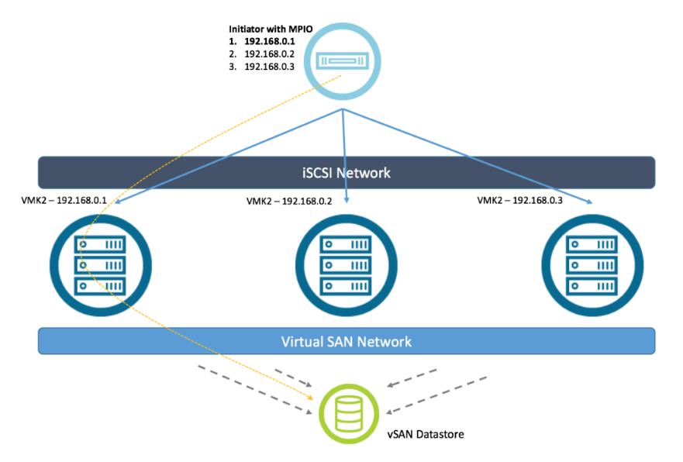
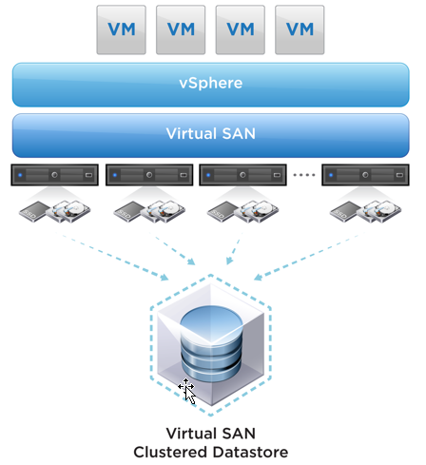
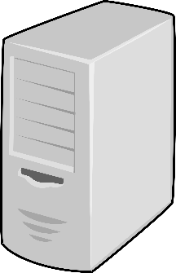
IBM Cloud – ‘Block’ Decision Tree – Mixed Storage Requirements
vSAN iSCSI Targets extend storage support to physical servers via iSCSI. This enables physical servers to access vSAN Storage via iSCSI whilst utilising all the vSAN Data Servers such as Storage Based Policy Management, RAID policy/Erasure Coding and other characteristics such as Deduplication/Compression and vSAN Native Encryption. In terms of security it can utilise CHAP or mutual CHAP to secure access to the iSCSI LUNs. Note: For limited Use Cases of less than 50TB Useable and less than 30% of vSAN Useable Storage.
Bare Metal Server
iSCSI Access
Storage Strategy - Decision Trees - IBM Cloud – MIXED REQUIREMENTS

Slide 12
IBM Cloud – ‘File’ Storage Decision Tree
Compuverde supports CIFS and NFS. S3 and Swift require special approval for use.
Spectrum NAS is IBM’s version of Compuverde
See File Comparison table on Slide 50. See Cost Comparison table on Slide 52.
Performance and Endurance Storage support NFS. CIFS require external appliance to support protocol – custom solution required.
Storage Strategy - Decision Trees - ibm cloud file

Slide 13

IBM Cloud – ‘Object’ Storage Decision Tree
Storage Strategy - Decision Trees - ibm cloud Object Storage

Slide 14
Technology index
GTS Global Storage Strategy

Slide 15
Tiered classification
GTS Global Storage Strategy

Slide 16
Guidance
The Tiered Storage Classification tables provide performance (IOPS and MB/Sec) values for a large configuration of each model and tier. The estimates of performance for the various configurations are provided with the expectation that your workload can tolerate up to a 10 millisecond IO response time. If you require lower IO response times, then you must tune the configuration accordingly. Scaling the configurations down will reduce the performance of the design in a proportional manner. Each configuration is suitable for supporting a workload that averages to the stated values; workloads (LUNs) that exceed the stated IO Density (IOPS/GB) must be placed on a device of a higher tier to ensure adequate performance.
Tier 0 - Highest performance/availability
TIER | Storage Technology | Description | Technical Examples – High level Guidance – Local variations on technology exist
 |  |  | Technology | I/O Density | Performance range capability
TIER0 – Flash Systems Preferred Solid State drives alternate | Block | Ultra High Performance. Meet QoS for High End Fibre Channel Only for block | System Z - Mainframe DS8886 HPFE – Z TPF w/ET | >1** which equates to more than 100 IOPs per 100GB LUN | DS8886 -> Greater than 250,000 IOPs/5500+ MBs
 |  |  | Open Systems A9000 3.6 TB POD A9000 8.5 TB POD - Native via IBM Cloud Private Storage is strategy - SVC/Spec Virt use allowed (details on slides 85/86) - iSCSI/IPHyperStor preferred. - V9000, A9000R, FS900, V7KF, V5KF are not supported in this strategy
 |  |  |  |  | A9000 3.6 TB IOPs/Density 30.518 A9000 8.5 TB IOPs/Density 12.926 Greater than 500,000 IOPs mixed work load (70/30).
 | File - NAS |  | AFF A300 (2-node HA pair) 36 x 3.84 TB SSD (1 ½ DS224C shelves) Max shelves before new HA pair: 6 Performance (IOPS/TB): 3050 |  | AFF A300 -> 3050 IOPS/TB (meets most medium-large all flash workloads, 40GbE + 32 Gb FC ports – can scale to 5.9 PBs)
COST / PERFORMANCE / AVAILABILITY
DS8, A9000, XIV are encryption ready w/ISKLM. Encryption for Flash and V7K/V5K have special tactical best practices. See community for details
**Response times may increase exponentially above these ranges
Storage Strategy - Tier 0
Tier rating is based on performance AND reliability
Notes:
16

Slide 17
Tier 1 - High performance/availability
TIER | Storage Technology | Description | Technical Examples – High level Guidance – Local variations on technology exist
 |  |  | Technology | I/O Density | Performance range capability
TIER 1 | Block | High Performance. Drive up utilization of high-ended storage subsystems and still maintain performance QoS objectives. For low capacity requirements smaller less powerful devices may meet tier definition | System Z - Mainframe DS8886 w/SAS 600GB 10K disk drive and Flash (20%) RAID6 ONLY DS8884 can be used for smaller mainframe solutions – 50TB approx. demark. -- All RAID6 is now global guidance -- -- Mainframe only. | >1** which equates to more than 100 IOPs per 100GB LUN | DS8886 -> 200,000+ IOPs / 5000 MBs Greater than 600 IOPs/TB in a full 1536 drives configuration RAID 6 (large configuration) Greater than 1200 IOPs/TB in a full 1536 drives configuration RAID 1
 |  |  | Open Systems A9000 3.6 TB POD A9000 8.5 TB POD A9000 18 TB POD - Native via IBM Cloud Private Storage is strategy - SVC/Spec Virtualise use allowed (details on slide 85/86) - iSCSI/IPHyperStor preferred. - V9000, A9000R, FS900, XIV, V7KF, V5KF are not supported in this strategy |  | A9000 3.6 TB IOPs/Density 30.518 A9000 8.5 TB IOPs/Density 12.926 A9000 18 TB IOPs/Density 6.104
 | File - NAS |  | ** IBM Cloud Private Storage FAS8200- HA (2-node) 1TB NVMe FlashCache per controller 4 x DS224C shelf (24 x 1.8TB SAS each) Max shelves before new HA pair: 8 Useable space (4 shelves): 126 TB Performance (IOPS/TB): 850+ FAS9000-HA where performance and capacity warrant MetroCluster 4 x FAS8200 2-node clusters (HA pair at each site) 1TB FlashCache per controller 8 x DS224C shelf (24 x 1.8TB SAS each) Max shelves: 16 Useable space (TB): 126 TB Performance (IOPS/TB): 850 + |  | FAS8200 ->850 IOPS/TB FAS9000 ->850 IOPS/TB recommended for large, multi-workload environments, when many expansion ports or massive scale out is required.
COST / PERFORMANCE / AVAILABILITY
DS8, A9000, XIV are encryption ready w/ISKLM. Encryption for Flash and V7K/V5K have special tactical best practices. See community for details
**Response times may increase exponentially above these ranges
Storage Strategy - Tier 1
Tier rating is based on performance AND reliability
Notes:
17

Slide 18
Tier 2 – On Premise
TIER | Storage Technology | Description | Technical Examples – High level Guidance – Local variations on technology exist
 |  |  | Technology | I/O Density | Performance range capability
TIER2 ON PREMISE | Block | Medium Performance. Meet QoS for applications/data that resides here. For low capacity requirements smaller less powerful devices may meet tier definition | System Z - Mainframe DS8886 w/SAS 600GB 10k disk and Flash (20%) RAID6 arrays – -- All RAID6 is now global guidance -- -- Mainframe only DS8884 can be used for smaller mainframe solutions – 50TB approx. demark. | >0.5** which equates to more than 50 IOPs per 100GB LUN | DS8886 -> less than 80,000 IOPs or less than 3,000 MBs Less than 600 IOPs/TB in a full 1536 drives configuration RAID 6 Less than 1200 IOPs/TB in a full 1536 drives configuration RAID 1
 |  |  | Open Systems ** IBM Cloud Private Storage Fibre Channel or IPHyperStor (iSCSI) for fabrics V5030 or v7000 gen2+ SAS 900GB 10k and SSD Easy using DRAID6 -- V5010 and v5020 not approved |  | V5030 Gen2 (block) -> less than 40,000 IOPs or less than 750 MBs V7000 Gen2+ (block) -> less than 75,000 IOPs or less than 1,250 MBs
 | File |  | ** IBM Cloud Private Storage FAS8200 (HA 2-nodes) with 1TB or 2 TB NVMe FlashCache depending on workload 2 x DS4246 shelves (24 x 4TB SATA each) - 122 TB usable - Minimum shelves: 1 (24x4TB SATA) Maximum shelves: 12 (288x4TB SATA) Performance option to use 1.8 SAS drives if performance indicates SDS - Compuverde |  | FAS8200 with FlashCache+SATA-> 200-400 IOPS/TB FAS2650 with FlashCache+SAS-> 800 IOPS/TB FAS2620 with SATA-> 25-125 IOPS/TB
COST / PERFORMANCE / AVAILABILITY
DS8, A9000, XIV are encryption ready w/ISKLM. Encryption for Flash and V7K/V5K have special tactical best practices. See community for details
**Response times may increase exponentially above these ranges
Storage Strategy - Tier 2 - ON Premise
Tier rating is based on performance AND reliability
Notes:
18

Slide 19
Tier 2 – IBM Cloud
TIER | Storage Technology | Description | Technical Examples – High level Guidance – Local variations on technology exist
 |  |  | Technology | I/O Density | Performance range capability
TIER2 IBM CLOUD | Block | Medium performance. Cloud and Commodity Storage. | SDS Block Cloud Spectrum Accelerate. See best practices (and slide later in deck). 50TB min. If smaller needed use Endurance or Performance offering from IBM Cloud. (only in IBM Cloud) vSAN for VMWare environments and limited iSCSI use case. See best practices (only in IBM Cloud) |  | Spectrum Accelerate SDS Block – 10K IOPs per node vSAN SDS Block – Between 15k IOPs to 22k IOPs per vSAN host Note: improvements can be made using Optane PCIe SSDs
 | File | Medium performance. Cloud and Commodity Storage. | File Interface SDS File Cloud Options NetApp ONTAP Select (only in IBM Cloud) Compuverde |  | See Cookbooks
COST / PERFORMANCE / AVAILABILITY
Storage Strategy - Tier 2 - IBM Cloud
Tier rating is based on performance AND reliability
Notes:
19

Slide 20
Tier 3/4
TIER | Description | Technical Examples – High level Guidance – Local variations on technology exist
 |  | Technology | Direct Attached (NAS) strategy | I/O Density | Performance range capability
TIER3 | Low Performance. Meet QoS for applications/data that resides here. Fibre Channel Only for block | V5030 or v7000 gen2+ with 4 TB NL-SAS using DRAID6 Include Read Intensive SSD drives and use Easy Tier (on SVC if applicable) V5030 is strategic behind SVC | FAS8200 (HA 2-nodes) with 1TB NVMe FlashCache 2 x DS4246 shelves (24 x 6TB SATA each) - Minimum shelves: 1 (24x6TB SATA) Maximum shelves: 12 (288x6TB SATA) FAS2620 (HA 2-nodes) with 256 TB NVMe FlachCache Mininum config: 12 x 6 TB SATA (Internal) Maximum config: 132 x 6 TB SATA | >0.1** which equates to more than 10 IOPs per 100GB LUN | V5030 (block) Less than 70 IOPs/TB DRAID6 V7000 gen2+ (block) Less than 100 IOPs/TB DRAID6 FAS8200 with FlashCache+SATA-> 100-200 IOPS/TB FAS2620 with SATA-> 25-125 IOPS/TB
TIER3b | Low Performance. Meet QoS for applications/data that resides here. Fibre Channel Only for block minus SDS. SDS will be iSCSI | SDS Block (IBM Cloud) Spectrum Accelerate. See best practices (and slide later in deck). 50TB min. If smaller needed use Endurance or Performance offering from IBM Cloud. (only in IBM Cloud) vSAN for VMWare environment and limited iSCSI use case. See best practices. (only in IBM Cloud) | SDS File Offering Compuverde – 4TB or 6TB drives. NetApp OnTap Select (IBM Cloud) NetApp Office FAS2650 (HA 2-nodes) with 512 TB NVMe FlachCache Mininum config: 24 x 1.2 TB SAS (Internal) – 18.5TB usable Maximum config: 144 x 1.2 TB SAS – 128 TB usable FAS2620 (HA 2-nodes) with 256 TB NVMe FlachCache Mininum config: 12 x 4 TB SATA (Internal) – 31TB usable Maximum config: 132 x 4 TB SATA – 370 TB usable |  | Spectrum Accelerate SDS Block – 10K IOPs per node vSAN SDS Block – Between 15k IOPs to 22k IOPs per vSAN host Note: improvements can be made using Optane PCIe SSDs SDS File – see Cookbooks SDS Object: Performance is high configuration dependent and measured in GETs and PUTs. Less than 25,000 IOPs or less than 300MB/sec
TIER4 | Archival, long term retention vaulting media, unstructured data | Cloud Object Storage Tape ATLs, (see page 67 for tiered DP&R Classification details) | IBM Cloud Infrastructure IBM Cloud Object Storage Public/Shared IBM Cloud Infrastructure NAS - Endurance Storage |  | N/A Tier based on features.
COST / PERFORMANCE / AVAILABILITY
DS8, A9000, XIV are encryption ready w/ISKLM. Encryption for Flash and V7K/V5K have special tactical best practices. See community for details
**Response times may increase exponentially above these ranges
Storage Strategy - Low Tiers
* XIV should not be used alone for transaction intensive workloads (under 3ms response) and CACHE unfriendly workloads. Use FS too.
** SoNAS, Scale, V7KU, V7KF, V5KF not approved for GTS SO usage.
*** Recommendation is to run DISK Magic to confirm drive selection/amount needed/DA Pairs needed
Notes:
20

Slide 21
On-Premise BLOCK & FILE
GTS Global Storage Strategy

Slide 22
Offering introduction: IBM Cloud Private Storage
In GTS data center or on customer premises
Fully managed storage capacity delivered “as a service” in standard offerings
Dedicated hosted private cloud in GTS data center or on customer premises
Leverages technology evolution to Flash, SDS, iSCSI – for block or file
Pay per consumption model - $/GB/month
Offering maintains architectural control
Always on encryption (block R1)
For more information
(Internal) Sales Essentials kit, including customer / seller presentations – Link
(External) Marketplace page(s) – Link
GDA - Link
ON Premise - Storage offering

Slide 23

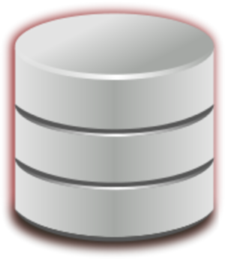
IBM Cloud Private Storage (R2) Multiple Data Tiers with “no surprise” pricing
New
All Flash block storage
Low latency all flash array
Starting at $0.16/GB/mo.
4 to 6 IOPS per GB – up to 500,000 per device
99.99% availability
All Flash file storage
Low latency all flash filer
Starting at $0.16/GB/mo.
2 to 4 IOPS per GB – up to 350,000 per device
99.99% availability
New
Clarified
Performance block storage
Efficient Tier 1 SAN array
Starting at $0.12/GB/mo.
1 IOPS per GB – up to 100,000 per device
99.99% availability
Performance file storage
Business critical NAS array
Starting at $0.12/GB/mo.
1 IOPS per GB – up to 100,000 per device
99.99% availability
Capacity used is measured daily and charged monthly based on highest daily usage
Pricing in USD, measuring allocated capacity, subject to change, other country pricing may vary
SAN fabric and data migration not included in rates
Standard file storage
Cost efficient NAS array
Starting at $0.08/GB/mo.
0.5 IOPS per GB – up to 75,000 per device
99.99% availability

Slide 24
Minimum capacity for Cloud Private Storage
 | Minimum capacity (TB)
Customer | 500 | Total customer Cloud Private Storage capacity across all sites and data tiers, measured at a point 6 months from initial deployment
Each data tier, per site* | 50 | *Exception: Performance block minimum - 175TB allocated, 125TB written
Waivers | If the All Flash Block minimum is met, the Performance block minimum at that same site is waived Example: If a site has 50+TB All Flash Block, any size Performance Block in that site is allowed If the Performance Block minimum is met, the All-Flash Block minimum at the same site is waived Example: If a site has 175+TB Performance Block, any size All-Flash Block in that site is allowed

Slide 25
IBM Cloud Private Storage – is this the right offering for me?
Refer to the rest of the strategy
Does client have >100TB data?
Propose: IBM Cloud Private Storage
No
Yes
Refer to IBM Cloud Object Storage
Requirement for object storage?
Yes
No
Refer to IBM GTS custom storage
Inflexible “non-IBM” HW requirement?
Yes
No
Client up for refresh or unsatisfied or rebidding?
(no action necessary)
No
Yes
ON Premise - Storage offering

Slide 26
IBM Cloud Private Storage – what data tiers?
Structured or unstructured data?
File storage
Block storage
Mostly unstructured
Mostly structured
What is need? performance or cost?
What is need? performance or cost?
Cost
Performance
Cost
Performance
Both!
Both!
Mix of both tiers
Mix of both tiers
Performance File
Standard File
All-Flash Block
Performance Block
Or Cloud Object Storage
ON Premise - Storage offering

Slide 27
IBM Cloud Private Storage - Gotcha’s and details
Because of the disparate SAN deployments and non-standard architecture you MUST deploy an integration or access switch for your DATA network
AT NO TIME EVER will a Client be granted management access
Future releases will move to multi-client tooling to reduce costs
The offering can include snapshots and replication
The offering DOES NOT include Resiliency Offerings such as Disaster Recovery and Standard Tape Backups – We are happy to engage the DRaaS Offering and/or Resiliency Team as needed.
Local Resources must be requested where desired; Standard is US Leadership (20%) and Global Resources (80%) and may deviate based on Geography
Premier Storage Infrastructure Services will be delivering this offering world-wide
Release 1 will feature helpdesk interaction only—we wanted to provide a human interface to start
Data Center Services do not change from how they are done today
Storage Vendors and Backing Products may change from time-to-time; this is a utility service and it will evolve as needed.
ON Premise - Storage offering

Slide 28
IPHyperStor – On-Premise Enterprise Storage Fabric (iSCSI)
iSCSi based architecture for Block Storage
High performance - Tier 1
1 ms average response time w/A9000 over 24 hour period and 99.99% SLA
New greenfield – instead of Fiber Channel
Heading to converged SDN/’SDS’ – thru 2018.
Based upon A9000 POD All Flash as primary storage option
Utilizes native features of A9000 such as Compression/de-dup, thin provisioning, replication, encryption, etc…
3:1 baseline reduction for A9000
GDA - GTS Software Defined Storage IPHyperStor (cookbook, sales collateral, etc): https://w3.gsar.ibm.com/services/gsar/gda/sbb_details.xhtml?id=418
ON Premise - IP Fabric Option

Slide 29
IBM FlashSystem A9000 Pod
FAST
SCALABLE
IBM FlashCoreTM technology
Consistent low latency even with full-time data reduction
Rated for sustained 2+ million IOPs @ sub-millisecond response
Scale out to multiple petabytes to quickly accommodate your growth
Hyper-Scale framework
Balance between Storage Arrays with Hyper-Scale Mobility Manager
EFFICIENT
AUTOMATED
Flash-optimized pattern removal, deduplication and compression (3:1)
Thin provisioning and snapshots maximize storage efficiency
Grid-scale automatically redistributes across all resources available
No hot spots, zero tuning
FEATURE-RICH
SECURE
Intuitive user interface
Redirect on Write Snapshots
Asynchronous Replication
Synchronous Replication
VMware integrated
Linked to OpenStack
IBM FlashCore technology with IBM Variable Stripe RAIDTM protection
Five 9’s availability
Survive controller failures without performance degradation
Hardware-based data at rest encryption (SKLM / KMIP)
A grid-scale, all-flash storage platform designed to drive your business into the cognitive era
ON Premise - Block Storage - Flash system
Notes:
This is a fully integrated, bundled rack based solution that is a great option for industry leaders.
Again, I won’t go through every feature on this page, but instead just wanted to call out some of the primary benefits:
It’s also built with FlashCore technology, and has flash-optimized data reduction features to make it a cost-effective all-flash array.
It makes scaling incredibly easy for our customers because it has a grid-architecture, which means that when you add capacity, it automatically rebalances workloads across all available resources. This automation will greatly simplify our customers’ lives.
Finally, of course we have the enterprise-class security required in a grid-scale, rack solution, as well as the wide breadth of integrated features that are also available on the FlashSystem A9000.

Slide 30
IPHyperStor – why replace XIV?
Configuration | FlashSystem A9000 - Performance Optimized | XIV Gen 3 (314) - Capacity Optimized
Performance | Up to 2.0 million IOPS (70/30) 250 microsecond latency Consistent low latency for mixed workloads | Up to 150,000 IOPS (70/30) 1.5 millisecond latency Great performance for smaller active data sets
Capacity | 12x 3.6 129 TB 12x 8.5, 306 TB 12x 18 TB 648 TB (All flash) IBM FlashCore™ technology | 354TB to 970TB effective (HDD) Flash SSDs as Cache
Architecture | Rack-based units offering. Depending on size and performance needed see above capacity. | Integrated rack-based offering, InfiniBand backplane Minimum of 6 up to 15 modules
Data Reduction | Flash-optimized data reduction suite includes pattern removal, deduplication and compression; Reduction algorithm executes across all grid elements | IBM RACE engine for Real-time Compression Selectable Compression (up to 5:1 data reduction) Reduction algorithm executes across up to 15 modules
User Interface | Easy enough for non-administrator tenants to use but powerful enough for a storage admin | Award winning XIV table driven interface
Quality of Service | QoS for every volume, pool or host | QoS for performance groups
ON Premise - Block Storage - Flash system

Slide 31
All Flash Building Blocks FC & iSCSI (no AIX w/iSCSI) Preferred design
IBM Spectrum Control
IBM
ALL Flash
High Performance
Cannot do Storage HA like SVC ESC or HyperSwap (2Q18)
No Tiering
All High Performance Storage
IBM A9000
Using ONLY the A9000 Pod
Small is 3.6 TB 12 modules
Medium is 8.5 TB 12 Modules
Large 18 TB 12 modules
Based on 80% utilization
Allocated
All Flash &
Performance Block
Simplified infrastructure
Using iSCSI (or FC)
1024 ASYNC volume replication Limit per device – 12.2.1 and above
1 Encl | 1 Encl | 1 Encl
3.6 | 8.5 | 18
129.6 | 306.0 | 648.0
IBM A9000
Included are guides for an all Flash environment storage design based on the IBM A9000 w/3:1 opt and 150% thin (80% used)
Both devices offer two network options; iSCSI and Fiber Channel. iSCSI is overall the price performer and recommended in our strategy but FC needed for key use cases.
ON Premise - Block Storage - Flash system
Notes:
31

Slide 32
Spectrum Virtualize vs All Flash A9000
All Flash A9000 is our current distributed block strategy. We are moving away from storage virtualization. The following are acceptable reasons to deviate from the All Flash direction.
I need local storage high availability and distant DR replication. Not available with A9K today.
I am fully Spectrum Virtualize deployed and its been very stable and client is happy with design.
The 1024 volume limit per A9K is not acceptable. 1024 is at 12.2.1 and higher.
** Roadmap is a target and is not guaranteed
ON Premise - Block Storage - Options
Notes:
32

Slide 33

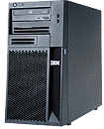

Spectrum Virtualize If Required Only SAN Volume Controller (SVC)
GDA – Spectrum Virtualize : https://w3.gsar.ibm.com/services/gsar/gda/sbb_details.xhtml?id=103
SVC virtualises backend storage system from either one or multiple vendors enabling capabilities like easy tiering of storage and SVC Enhanced Stretch Cluster between multiple sites.
Make changes to the storage without disrupting host applications
Manage the storage pool from a central point
Virtual
Disk
Virtual
Disk
Virtual
Disk
Virtual
Disk
SAN
Automated use of FlashSystem/SSD through tiering with Easy Tier
Spectrum
Virtualize
Enable Inline Compression, Thin Provisioning, Encryption and Transparent Cloud Tiering for all storage
Storage Pool
Internal disk
Flash
IBM
HP
Apply common Advanced Copy Services and HyperSwap across the storage pool
Combine the capacity from multiple arrays into a single pool of storage
Oracle
HDS
EMC
NetApp
ON Premise - Block Storage - Virtualization
Notes:
33

Slide 34
Storage Virtualization Building Blocks
IBM Storage Virtualization
SAN Volume Controller (SVC)
IBM SV1 1.5 PB + per full cluster
IBM Storage Virtualization Layer
IBM Spectrum Control
IBM
Data Compression & Thin Provisioning
IBM
Intelligent
Information
Lifecycle
Management
IBM VSC
SVC, FC Manager, Spectrum Control
IBM Multi Tier data Auto migration
Layer based on business need
IBM
Easy Tier
Tunable based on historical & required performance guidance
IBM Strategic Storage Building Blocks
Mix and Match for performance, capacity, and cost
IBM Flash
A9000 3.6 TB Modules
High Performance
IBM Flash
A9000 8.5 TB Modules
High Performance
IBM Flash
A9000 18 TB Modules
High Performance
IBM V5030
Tier 3
Controller w/SSD
Expansion w/4 TB SATA
We are introducing a new Building block based solution guide.
For A9K, please assume 2.5:1 optimization. Dedup/compression done at A9K level vs SVC/Spectrum Virtualize level.
Included are guides for a standard Small, Medium, and Large storage design.
Because no client is the same these are guides, the strength of the building block design is it allows us to use the different storage blocks to best meet the needs for storage, performance, and cost using the IBM GTS Storage Strategy guide.
All IBM Storage except XIV is now RAID6 and V5030 and V7000 are DRAID6
ON Premise - Block Storage - Virtualization
Notes:
34

Slide 35
NetApp Appliance
All protocols well supported
Scale out with CDOT capabilities
On Premise solution only
When to consider
Mission Critical workloads
Highest Maturity required
General purpose NAS workloads - highest adaptability
Okay with higher cost for premium capabilities/compatibility
ON Premise - File Storage - Appliance

Slide 36
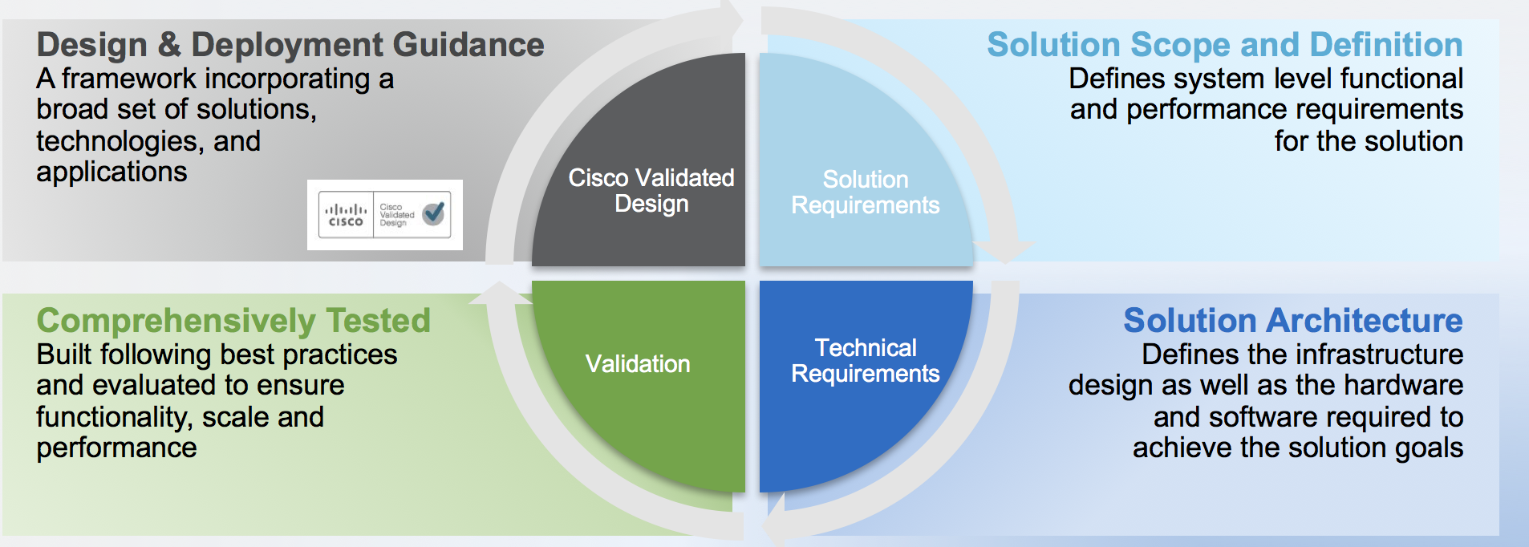
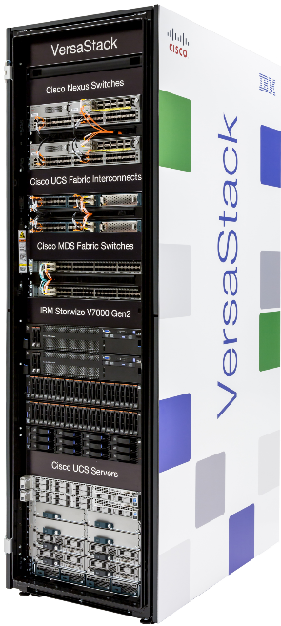
IBM IPHyperStor & Versastack
IBM Cloud Private Storage – For clients requiring on premise enterprise Hyper-Converged
CISCO validated design
All iSCSI based switches
Number of spines (9364s) depends on storage TBs used in pod
Design also available with Fiber Channel but iSCSI lead with

Slide 37
Off-Premise (IBM CLOUD)
GTS Global Storage Strategy

Slide 38
SDS Guidance in Off-Premise (IBM Cloud Infrastructure)
Mission critical* applications at this time are not recommended for placement in IBM Cloud** (excluding CMS) on Bare Metal Software Defined Storage.
Whilst these SDS solutions in IBM Cloud Infra on bare metal server infrastructure can be highly available, application and workloads placed in Cloud should be acceptable to outages and/or performance impacts on occasion. Non-mission critical workloads are the use case for our GTS SDS capabilities in IBM Cloud Infra at this time.
However, applications which are classified as Cloud Native*** (born and designed for anomalies in cloud) and therefore can handle some instability and performance fluctuations in the Compute, Storage and Network are applicable for a move to IBM Cloud even if they are Mission Critical. Most GTS clients want to move legacy so confirm in writing if they state this.
If, there is a mandate to move mission critical workloads to IBM Cloud, GTS’s recommendation is to use IBM Cloud Endurance Offering. See decision trees and broader GTS Storage strategy deck.
Mission critical refers to any factor of a system (components, equipment, Personnel, process, procedure, software, etc.) that is essential to business operation or to an organization. Failure or disruption of mission critical factors will result in serious impact on business operations or upon an organization.
Some red flags that would indicate if the workload is mission critical are:
Availability SLA above 99.5%
Aggressive storage response time asks, e.g. response time below 5ms
High performance requirements similar to On-Premise enterprise class Tier 0 or Tier 1 storage
IBM Cloud - Storage Guidance
Notes:
38

Slide 39
Considerations for Software Defined Storage
When outages for Microcode Updates are Acceptable
Some SDS Platforms will require outages 1-2 times per year for code upgrades. Mitigation varies based on deployment location and hardware. Be Aware of the limitations of your design!
When Use of Commodity Hardware is Appropriate
Commodity Hardware is typically 99.9% availability & durability is 99.95%
Some SDS Software will create Grids or Clusters to provide better availability—not all. Be Aware.
Your customer WILL NEED to change their application designs to compensate for this.
When your Systems/Hosts will be local to your SDS vs. Remote
Some SDS Software is designed to handle remote requests (Object) and some are not. Be Aware.
When your performance isn’t High Demand or can vary significantly between transactions
SDS Technology depends heavily on caching intelligence. If this is defeated, performance will suffer.
CUSTOMERS SHOULD NOT PUT HIGHLY TRANSCATION HEAVY OR MISSION CRITICAL WORKLOADS ON SDS AT THIS TIME.
IBM Cloud - sds recommendations

Slide 40
Making Good Choices with Software Defined Storage
Please be aware that moving everything to SDS is a bad idea. Current guidance recommends non-mission critical work loads.
30% of data a good starting target and a maximum of 70%. Assessment based on client data important. Caution should be used in determining amount of data to move to SDS as not all SDS deployments are highly available.
Expect changes in application design to tolerate a less available infrastructure. Focus should be on non-critical data, which can tolerate outages and interruptions while they adapt their applications.
Lower availability and durability.
IBM Cloud - sds recommendations

Slide 41
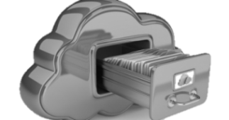
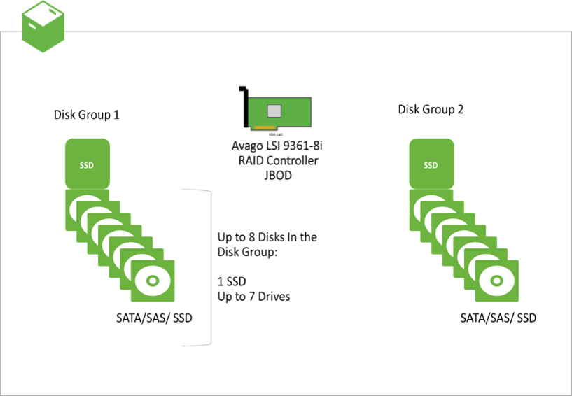
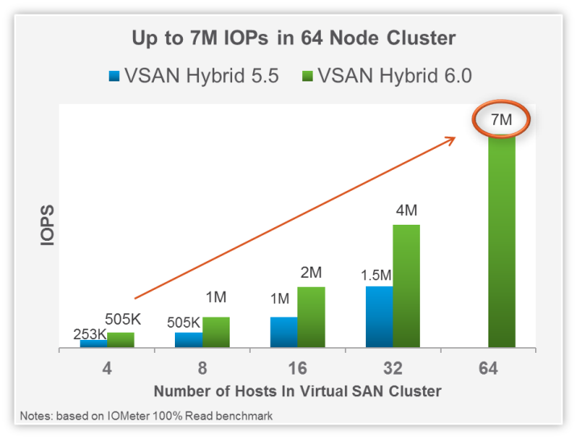
VMware vSAN
GDA - GTS Software Defined Storage vSAN: https://w3.gsar.ibm.com/services/gsar/gda/sbb_details.xhtml?id=545
Use case VMware Virtual Machines with non-shared storage on dedicated IBM Cloud Bare Metal servers. Limited iSCSI for Bare Metal Servers Current State Positioned VMware vSAN as primary block storage option for VMware SDDC deployments and limited iSCSI Use Cases Better cost, availability, scalability and performance range Simple operational management as tightly integrated with VMware (vCenter) Reference Architecture completed with numerous solutions already deployed and in production such as WPP, Westpac, Blueprism, etc… IMI enabled for GTS Delivery Support Testing was done on vSAN 6.6 with a 4 node cluster (RAID 5, /w Dedupe/Compression and Encryption) ~17k IOPs per Disk Group to ~22k IOPs per Disk Group depending on configuration | Current Direction Hybrid Configuration - Mixture of SSD and SATA No longer part of GTS Storage Strategy. Migrate to vSAN All Flash before June 2018 All Flash Configuration with Dedupe/Compression, Encryption, Erasure Coding and limited iSCSI usage Operations Guide TCO and Support Model Best Practices Implementation Guide Recommended Hardware and Sizing's 2018 Future Directions Stretch Clusters in IBM Cloud Operational Enhancements Larger SSDs, NVMe/PCIe SSDs, etc… On Premise Deployments (limited Use Cases) and Remote Office Branch Office Small deployments, no existing SAN, and existing switches which are not certified with IPHyperStor
*Performance Benchmarks based on non-IBM Cloud deployment
IBM Cloud - Vmware storage - vsan (sds)

Slide 42
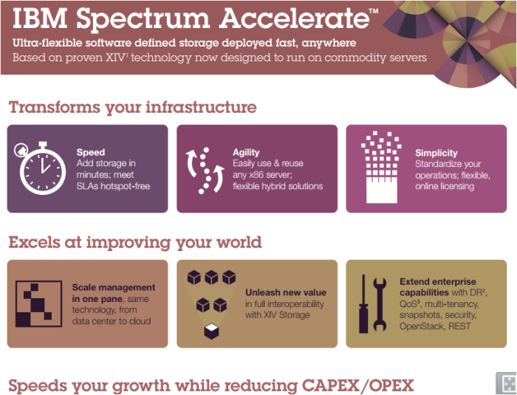
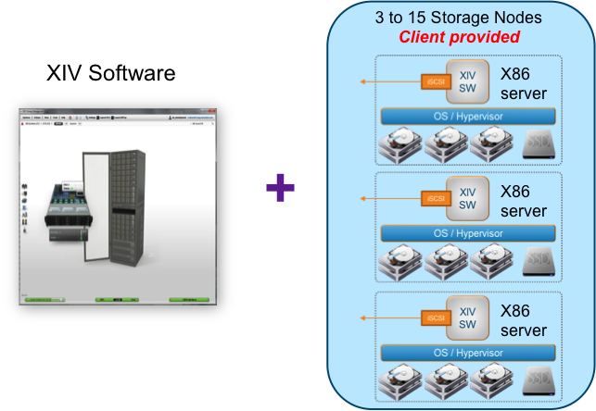
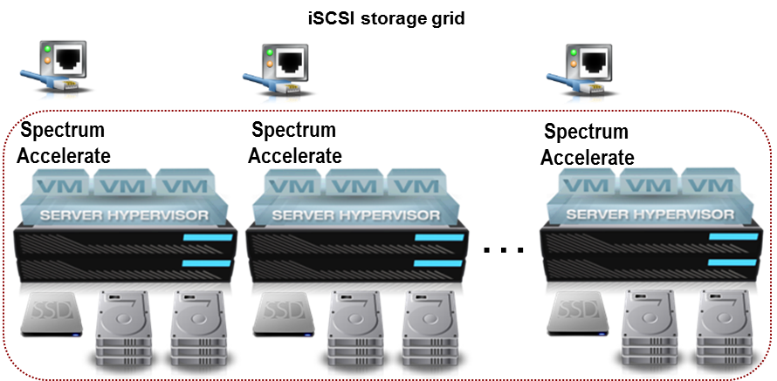
Spectrum Accelerate
GDA - GTS Software Defined Storage Spectrum Accelerate: https://w3.gsar.ibm.com/services/gsar/gda/sbb_details.xhtml?id=388
Use case Non-shared storage on dedicated IBM Cloud Bare Metal servers. Non-VMware workloads. Disaster Recovery target for On-Premise XIV/A9KR. Current State For non-VMware based storage requirements. Provides better overall IBM revenue opportunity. Adopted on a few GTS clients (Fannie Mae, RBC, Panasonic, Evry, etc). IMI enabled for GTS Delivery Support. | 2018 Future Directions Dependent on Systems Group Spectrum Accelerate development roadmap. Lack of investment (and feature improvements) therefore alternatives are being investigated. Lead with vSAN for VMWare-based deployments Lead with Spectrum Accelerate for DR-to-Cloud Targets for Accelerate Family
IBM Cloud - block - spectrum Accelerate (sds)

Slide 43
NetApp OnTap Select
GDA - GTS Software Defined Storage NetApp OnTap Select: https://w3.gsar.ibm.com/services/gsar/gda/sbb_details.xhtml?id=638
Use case NetApp functionality on IBM Cloud Servers Dedicated Storage array NFS/CIFS protocol support Current State 4 node or 2 node cluster 2 models, high performance (based on SSDs) or capacity bill of material (based on SATA disks) Managed using existing NetApp tooling and management consoles with the same look and feel as legacy NetApp Provides NetApp functionality such as SnapMirror capabilities to replicate to On-Premise NetApp and includes functionality such as Data Reduction | When to consider Non-mission critical NAS needs within IBM Cloud Want same capabilities of NetApp appliance in cloud Snap Mirror / Snap Vault pairing with on premise 2018 Directions Scale up and scale out Operational Enhancements Larger SSDs, NVMe/PCIe SSDs, etc…
IBM Cloud - file - ontap select (sds)

Slide 44
IBM Cloud Block and File Storage Offering
Block Storage – Link
File Storage – Link
IBM Cloud - IBM Cloud provided storage options

Slide 45
Both ON-Premise and Off-Premise (IBM CLOUD)
GTS Global Storage Strategy

Slide 46
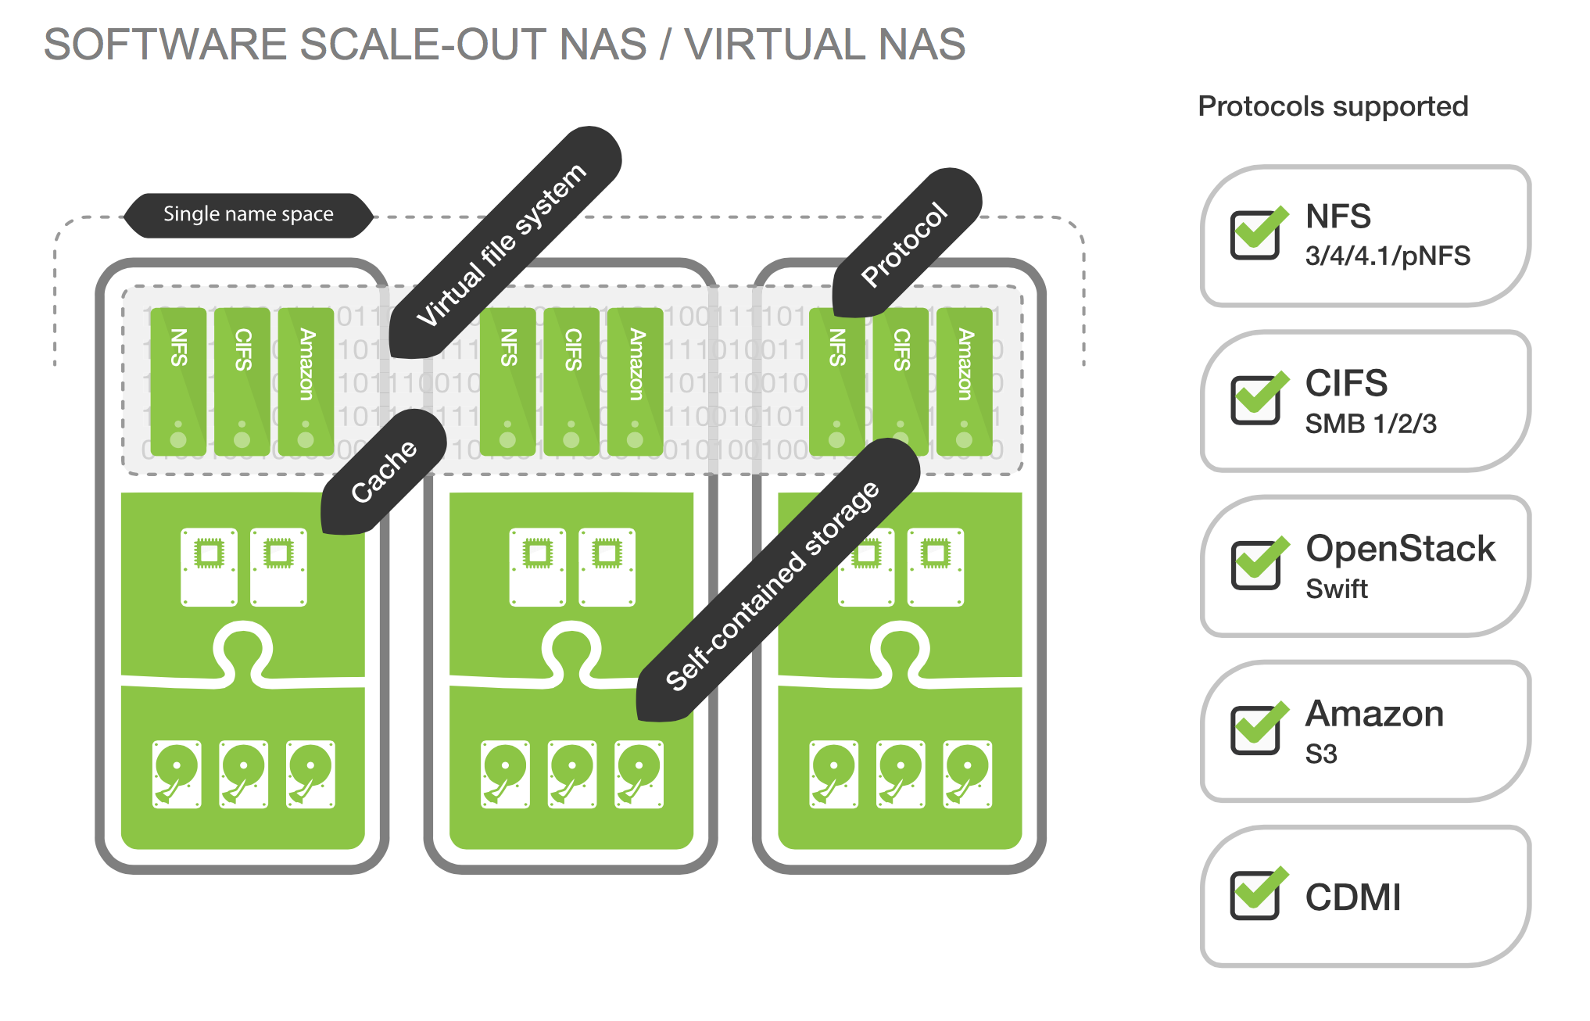
Compuverde
GDA - GTS Software Defined Storage Compuverde: https://w3.gsar.ibm.com/services/gsar/gda/sbb_details.xhtml?id=547
Use case Designed as an alternative to NetApp for lower end file storage Dedicated Storage array Protocols supported shown below Enabled for both On-Premise and IBM Cloud – same topology Current State Scale out architecture – 4 node minimum Capacity AND performance scales linearly with nodes Able to create performance tiers of nodes within the same file space Distributed copies or erasure coding on any file directory boundary – offers wide range of resiliency options | When to consider Cost effective, Scale out NAS requirement More specific application environment - less user home directory Don’t require high level of parallel functionality to NetApp ISV support Detailed reporting options Tooling based on NetApp interfaces Replication 2018 Future Directions Hybrid Cloud - DR replication NDMP backup Compression Feature upgrades to closer mirror NetApp functionality
Note: Mission Critical restriction on all SDS on IBM Cloud - including Compuverde
Spectrum NAS is IBM Systems version of Compuverde
On premise or IBM Cloud - File - Compuverde (sds)

Slide 47
IBM Cloud Object Storage
Formerly known as Cleversafe
Object interface (S3)
Scale Out architecture – segmented node roles
Local or globally dispersed erasure coding
Dramatically increased storage efficiency when using globally dispersed erasure coding compared with local protection and DR copies
Same topology for on premise and IBM Cloud deployments
On premise or IBM Cloud – Object storage - ICOs (sds)

Slide 48
Comparison index
GTS Global Storage Strategy

Slide 49
Block Technology Strength/Weakness Comparison
Function | A9K/A9KR | vSAN | Spectrum Accelerate
Deploy on IBM Cloud | No | Yes | Yes
On Premise Option | Yes | Specific use cases - Tooling POD and Remote Office Branch Office (ROBO) Seek approval from Jim Olson and Jack Cherkas | No
Mission Critical Capable | Yes | No | No
Operational Maturity | Strong | Very good | Moderate
Protocol Support | Strong | Moderate | Moderate
Scaling | Strong | Strong | Weak
Replication | Strong | Relies on other technologies | Strong
Strategic | Yes | Yes | No
Storage Strategy - block technology comparison

Slide 50
File Technology Strength/Weakness Comparison
Function | NetApp appliance | NetApp ONTAP Select | Compuverde
Deploy on IBM Cloud | No | Yes | Yes
On Premise Option | Yes | No | Yes
Mission Critical Capable | Yes | No | No
Operational Maturity | Strong | Strong | Good
Protocol Support | Strong | Strong | Strong
Scaling | Strong | Moderate | Very Strong
Replication | Strong | Strong | Weak
Backup Options | Strong | Strong | Weak
Strategic | Yes | Yes | Yes
Storage Strategy - File technology comparison

Slide 51
Costs (not price)
GTS Global Storage Strategy

Slide 52
Costs (not prices)
Technology | Use Case/comments | Storage Tech Cost * | Solution Cost **
Non-virtualized Enterprise Flash (A9000) All Flash Design *** | Super high performance on premise block storage. High feature/function. Mission Critical. | $$$ | $$$$$ - FC $$$$ - iSCSI
Non-virtualized Enterprise blended/tiered (A9000/XIV) 2 Tier building block design *** | Mixed super high performance and high performance. High feature/function. Mission Critical. | $$ | $$$$ - FC $$$ - iSCSI
Virtualized Enterprise blended/tiered (SVC) Traditional SVC Design | Virtualized blended performance solution. Super high end feature/function. Mission Critical. | $$$$ | $$$$$
SDS Block Off-Premise | Medium performance. Non-mission critical. Medium feature/function | $$$ - vSAN $$$$$ - SA | $$$$ - vSAN $$$$$$ - SA
SDS File On-Premise | Medium performance. Non-mission critical. Medium feature/function | $$ | $$$
SDS File Off-Premise | Medium performance. Non-mission critical. Medium feature/function | $$$ - CV $$$$ - NetApp OTS | $$$$ - CV $$$$$ - NetApp OTS
Cloud Object Storage – Bluemix dedicated/shared | Low performance – good for large objects like video/audio. Good for vaulting and archive. | $$ | $$$
Cloud Object Storage – On-prem IBM COS local | Low performance – good for large objects like video/audio. Good for vaulting and archive. | $ | $$
*Costs based on total Storage HW/SW/Maint
** Costs based on total HW/SW/Maint/Facilities/etc
*** A9000 requires some specific feature enhancements in order to move to our default standard solutions
--- Solution costs include needed labor for admin/arch/PCM and SW/HW including storage devices, fabric costs, Spectrum Control
--- Stated rates and ratios are accurate for a generic business environment and are only intended for high level discussion purposes. Any price presented to a customer should be developed from SDM/FwB and approved by a Pricer.
Stated rates and ratios are accurate for a generic business environment and are only intended for high level discussion purposes. Any price presented to a customer should be developed from SDM/FwB and approved by a Pricer.

Slide 53
Mandated Tooling
GTS Global Storage Strategy

Slide 54
Required Tools and Monitoring
GTS Automated Storage Provisioning (ASP)
built with OpenStack
Self-Service Provisioning
Enables Orchestration
All Distributed Storage environments require two tools:
Storage Monitoring and Alerting: https://ibm.biz/BdXKFd
Completes view of account infrastructure, raises visibility of storage issues and concerns
No additional server required - follow Storage Monitoring and Alerting cookbook
GTS Storage Automation Tools: http://bldgsa.ibm.com/projects/s/storage_automation/sat/SATHC.html
Enables health/compliance checking, inventory reporting, problem determination, and optimization.
Normally runs on same server as SRM tool (below)
Requires Windows server that is not dependent on storage or fabric being managed (see next page)
Includes VMware automation (ATS Heartbeat and SCSI ID, future: vSAN and NSX health check)
Environments over 200 TB usable space require three additional tools:
Note: Opting out of these tools in small environments results in increased Framework Blue labor
Automated Storage Provisioning: http://bldgsa.ibm.com/projects/s/storage_automation/sat/AutoPI.html
Enables self-service and API based provisioning and orchestration
Greatly improves response time for provisioning and eliminates redundant change control
Requires Linux server - can be dependent on managed storage - VM or cloud recommended
Storage Resource Management (SRM): https://ibm.biz/BdsLcN
Default is Spectrum Control Advanced (formerly TPC)
Required for all IBM storage, recommended for Netapp FAS and EMC VMAX
Deploy Arxview by Arxscan for all other types of storage
Vendor tools like NetApp OCI or EMC VIPR SRM are acceptable if client required (higher cost)
Requires Windows server that is not dependent on storage or fabric being managed (see next page)
Storage Fabric Management: https://ibm.biz/BdXR77 https://ibm.biz/BdXFjb
Deploy the tool from the switch / fabric vendor:
Fibre Channel fabrics : Brocade BNA/INA or Cisco DCNM
iSCSI fabrics: Arista CloudVision appliances or Cisco APICs
Requires server that is not dependent on storage or fabric being managed (see next page)
Storage Monitoring and Alerting
Storage SNMP alerts to Netcool according to cookbook
Tools in this box must not be dependent on the storage or fabric they manage
GTS Storage Automation Tools (SAT)
Health Check
Problem Determination
Storage Optimization
Storage Resource Management IBM Spectrum Control (TPC)
-or- Arxscan Arxview
Performance Management
Capacity Management
Storage Fabric Management
FC: BNA or DCNM
iSCSI: CloudVision or APIC
Notes:
54

Slide 55
Required Tools and Monitoring
GTS Automated Storage Provisioning (ASP)
built with OpenStack
Self-Service Provisioning
Enables Orchestration
Distributed Storage management server requirements
Automated storage provisioning is not required during an incident, and may be hosted on any type of server. Cloud and virtual servers are recommended for ASP.
The following tools needed to recover from storage incidents must not be dependent on the storage or fabric they manage to ensure they are available during an incident.
GTS Storage Automation Tools (SAT) typically hosted on same server as SRM tool
Storage Resource Management (TPC or Arxview)
Storage Fabric Management (BNA, DCNM, CloudVision, or APIC)
Storage management server options
Servers hosting these tools must not be connected to the storage or fabric being managed except through out-of-band management interfaces.
The simplest solution uses two small dedicated servers with internal storage
Virtual machines can be used, but hypervisor must not be attached to storage or fabric they manage
May be attached to a different SAN if it is managed by other storage management servers
Ensure storage management tools are not on VMs that boot from the managed storage
Storage management servers may be remote or in cloud only if the management network path is not dependent on the storage or fabric the manage
Firewalls, routers, VPNs, etc. in the management network path must not be on servers or hypervisors attached to the storage or fabric being managed
Ensure network components are not on VMs that boot from the managed storage
Other tools
For heavily virtualized environments with VMware and VMware vSAN considering utilizing vRealize Operations, vRealize Log Insight in conjunction with vRealize Network Insight if using VMware NSX.
Storage Monitoring and Alerting
Storage SNMP alerts to Netcool according to cookbook
Tools in this box must not be dependent on the storage or fabric they manage
GTS Storage Automation Tools (SAT)
Health Check
Problem Determination
Storage Optimization
Storage Resource Management IBM Spectrum Control (TPC)
-or- Arxscan Arxview
Performance Management
Capacity Management
Storage Fabric Management
FC: BNA or DCNM
iSCSI: CloudVision or APIC
Notes:
55

Slide 56
High availability
GTS Global Storage Strategy

Slide 57
Storage High Availability – Failure Domain Requirements
Our standard failure domain for storage devices that are not in a high availability design is approximately 600TBs calculated at 80% of usable capacity of given storage device.
If storage high availability is used, we allow up to 1200TBs (1.2PB) calculated at 80% usable capacity of given storage device.
Guidance and examples surrounding storage high availability.
Storage HA means you have two separate and complete copies of your data in two different storage devices (copy 1 in storage box 1 and copy 2 in storage box 2)
Both copies are in Sync. Zero data difference between both copies of data.
Active/Active or Active/Passive is acceptable. Example of Active/Active is Hyperswap (DS8 or A9K). Example of Active/Passive is NetApp Metro-Cluster.
High Availability is not Disaster Recovery by design. If want to do DR using SYNC, recovery must be automated and meet a 4 hour recovery time objective.
NetApp – AFF 700S required for all Flash and FAS8200 for Hybrid.
A9K – 425 model required.
Defines system
We highly recommend High Availability and Disaster Recovery (on the next slides)

Slide 58
Resiliency guidance
GTS Global Storage Strategy
Global SLE - IBM Resiliency Backup as a Service Community
https://ibm.biz/BdiG2u

Slide 59
GTS Spectrum Protect Backup Storage Strategy
GTS Spectrum Protect storage pool on On-Premise and IBM Cloud Data Centers Strategy
IBM Cloud: Bare Metal building block servers with local disk, Red Hat Enterprise Linux (RHEL) storage servers and Cloud Object Storage.
On-Premise: Storwize 5030 standard options for low cost storage on dedicated and shared environments and Cloud Object Storage.
For Backup as a Service (BaaS):
Use V5030 for all builds, very small cost diff between v5030 and v5020 + v5030 scale better for growth
Large: Database container and Active Logs disks: 800 GB E-MLC SSD DRAID6, Database backup and Archive logs disks: 1,8 TB SAS disks 10K rpm DRAID6, Storage pool disks: 6 TB NL-SAS 7.2k rpm DRAID6.
Medium: Database container and Active Logs disks: 400 GB E-MLC SSD DRAID6, Database backup and Archive Logs disks: 1,2TB SAS disks 10K rpm DRAID6, Storage pool disks: 6 TB NL-SAS 7.2k rpm HDD DRAID6
Small: Database container and Active Logs disks: 300 GB 15k rpm SAS HDD DRAID6, Storage pool, Database backup. Archive Logs disks: 3 TB NL-SAS 7.2k rpm HDD DRAID6.
If using traditional disk staging to tape: 1.2 TB 10K disks RAID6 for Storage pool and Archive logs disks, and 300 GB 15K disks RAID5 for Database container and Active Logs.
All disk storage with the same 70% labor reduction of the V5030, “SO Other Storage GB”
If using backup to VTL (ProtecTIER) (use same labor reduction as above) key to use the ProtecTIER Planner tool to properly estimate your repository size and performance here => https://w3-03.sso.ibm.com/sales/support/ShowDoc.wss?docid=B211929B17868C16
For more detailed BaaS building blocks guidance look in BaaS community here => https://ibm.biz/BdHHAm
IBM Cloud Object Storage (COS) aka Cleversafe guidance with Spectrum Protect
See Cloud Object Storage SolutionPa​c On-Premise Backup
Reach out to BJ Klingenberg, Mikael Lindström and Chris Bode for help

Slide 60


Disaster Recovery – Site to Site DR replication Recommended for all client solutions
Synchronous “Metro Mirror”
Up to 200km between sites for business continuity
As with any synchronous remote replication, performance requirements may limit usable distance
Host I/O completed only when data stored at both locations
Operates between SVC clusters at each site
Local and remote volumes may be on any SVC supported disk systems
Asynchronous “Global Mirror”
Up to 8000km distance between sites for business continuity
Does not wait for secondary I/O before completing host I/O
Helps reduce performance impact to applications
Designed to maintain consistent secondary copy at all times
Operates between SVC clusters at each site
Local and remote volumes may be on any SVC supported disk systems
Now have the ability to replicate to SDS in cloud as a lower cost alternative.
Available for both our Spectrum Virtualize designs as well as our native A9K designs. As mentioned above, we encourage all GTS clients to use.

Slide 61
Storage network
GTS Global Storage Strategy

Slide 62
Storage Area Networks (Fiber Channel and iSCSI)
Fiber Channel
Vendors
Brocade
Cisco
See Vendor Selection Guide
https://ibm.biz/BdXR7S
The Vendor selection will assist in selecting the best vendor for your solution
Always seek multiple vendor and source prices within the Guide criteria
Purchase
There are three purchase options for FC
IBM Supply Chain (eConfig)
IBM GARS
Buy Direct from the vendor
Brocade contact Gregory Fazio greg.fazio@Broadcom.COM
Cisco Contact is Jeff Gatz, jegatz@cisco.com
iSCSI
Vendors
Cisco
Arista
Design
Spine / Leaf
Purchase
Include Thomas Bish/Tucson/IBM in all communications. Tom can help assess the best vendor for your solution
Cisco Contact is Jeff Gatz, jegatz@cisco.com

Slide 63
Change Log
https://ibm.box.com/v/gtsstoragestrategychangelog
Backup Information
Recording - http://w3.tap.ibm.com/medialibrary/media_view?id=376681
Notes:
63

Slide 64
Detailed Technical Guidance Building Blocks

Slide 65
Building Blocks
GTS Global Storage Strategy

Slide 66
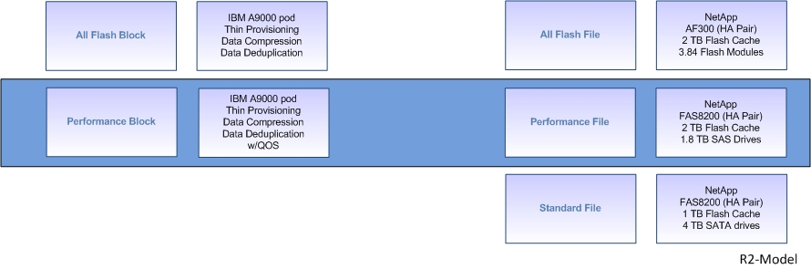
Offering introduction: IBM Cloud Private Storage Model
ON Premise - Storage offering

Slide 67
Distributed Storage: Strategic Standard Building Blocks For IBM Cloud Storage On Premise
SDS
File
Object
Block
IBM
Cloud Private Storage
IBM Cloud Private Storage Offering – strategic and preferred building block for On-Premise Enterprise Storage.
iSCSI fabric connected to A9000/A9KR (Flash storage with XIV SW), Compression, Thin Provisioning, & Flash Copy Both designed for Block Leverages native RTC.
Using Spectrum Control for monitoring and reporting is required
You CANNOT replicate compressed data between Spectrum Accelerate and IPHyperStor at this time. Update pending in 2019
IBM
IPHyperstor
Low cost On Prem File Storage Option – Current leading technology candidates
Options span from Tier1 (all SSD), Tier 2 (SSD cache with 2-4 TB disk), and Tier 3 (SSD cache with 4-6 TB disk)
NexentaStor – “Scale up” architecture based on dual controller with shared disk enclosures ZFS based file system
CompuVerde – “Scale out” architecture with cluster of 4+ servers with internal storage Distributed IO and protection across all nodes/disks – distributed copies or distributed erasure coding protection options
IBM
SDS File
Notes:
67

Slide 68
Distributed Storage: Strategic Standard Building Blocks For IBM Cloud Storage Off Premise
Non-Mission Critical workloads
Low cost storage based on commodity hardware
When your performance requirements aren’t super high
Includes VMware vSAN and Spectrum Accelerate
IBM
SDS Block
IBM Cloud Object Storage (formerly known as Cleversafe) with different models depending on requirements (On-Premise, Hybrid, Dedicated and Public). If Hybrid with custom solution capabilities, seek SME assistance.
Some good use cases include Archive, Vaulting, Content Repository, etc… accessed either via a gateway or direct API access.
IBM
SDS Object
Low cost IBM Cloud Infra Cloud File Storage Option
Options span from Tier 2 (all SSD) to Tier 3 (SSD cache with 6 TB Disk)
CompuVerde – Scale out architecture with distributed IO and protection (distributed copies or distributed erasure coding)
NetApp OnTap Select
IBM SDS File
Notes:
68

Slide 69
Distributed Storage: Strategic Standard Building Block For FC environments under 50 TB with NO SVC Appliance
V5030
IBM
Easy Tier
Storwize v7.7.1.x for Distributed RAID (DRAID) enhancements
All storage configured in DRAID6
One DRAID6 array for each drive type
All capacity in one MDISKGROUP
Enable Easy Tier
Do not use Thin Provisioning
Do not use Real Time Compression
Do not Cluster
Do not use for replication
Do not virtualize other storage
Building Block Guidance
All IBM Storage except XIV is now RAID6 and V5030 and V7000 are DRAID6
Notes:
69

Slide 70
Distributed Storage: Strategic Standard Building Block For 50-100 TB FC environments with NO SVC Appliance
V7000
Gen2+
Equipment Description | Unit Quantity | TB | % Data Spread
V7000 gen 2076-624 Controller | 1
2076-24F expansion | 3
Tier 1 3.84TB RI Flash | 12 | 23 | 25%
Tier 2 1.2 TB 10K | 12 | 23 | 25%
Tier 3 4TB 7.2K | 12 | 47 | 50%
Usable Capacity Use Compression @ 24% and Thin @ 9% |  | 100.8
Equipment Description | Unit Quantity | TB | % Data Spread
V7000 gen 2076-624 Controller | 1
2076-24F expansion | 6
Tier 1 3.84TB RI Flash | 18 | 54 | 22%
Tier 2 1.2 TB 10K | 96 | 91 | 37%
Tier 3 4TB 7.2K | 32 | 102 | 41%
Usable Capacity Use Compression @ 24% and Thin @ 9% |  | 247
IBM
Easy Tier
Storwize v7.7.1.x required for v7000 gen2+
All storage configured in DRAID6
One DRAID6 array for each drive type
All capacity in one MDISKGROUP
Enable Easy Tier
Data Compression
Thin Provisioning
IBM Spectrum Control for Monitoring and reporting
Real Time Compression requires compression card
Do not Cluster
May be used for replication (limit IOPS)
Do not virtualize other storage
All IBM Storage except XIV is now RAID6 and V5030 and V7000 are DRAID6
Notes:
70

Slide 71
Distributed Storage: Strategic Standard Building Blocks For IBM Storage Virtualization (SVC) – Storage Optimization
Recommended Optimization Configuration - Small
Tier 1 & 2 – A9000
Tier 3 – single mdiskgroup
One DRAID6 array for each v5030 drive type
Enable Easy Tier for both mdiskgroups
Manual Tiering
Recommended Optimization Configuration - Medium
Tier 1 & 2 – A9000
Tier 3 - single mdiskgroup
One DRAID6 array for v5030 SSDs
Two DRAID6 array for v5030 HDDs
Enable Easy Tier for both mdiskgroups
Manual Tiering
Recommended Optimization Configuration - Large
Tier 1 & 2 – A9000
Tier 3 – single mdiskgroup
One DRAID6 array for v5030 SSDs
Two DRAID6 array for v5030 HDDs
Enable Easy Tier for all mdiskgroups
IILM Tiering
All IBM Storage except XIV is now RAID6 and V5030 and V7000 are DRAID6
Notes:
71

Slide 72
Distributed Storage: Strategic Standard Building Blocks For IBM Storage Virtualization (SVC)
IBM Spectrum Control
Recommended Small Design
Approximately 560TB physically usable
Approximately 745TB logically usable
TCO calc at 80% allocated – 600TBs
4 node SV1 Cluster
IBM Storage Virtualization
SAN Volume Controller (SVC)
IBM SV1 1.5 PB + per full cluster
IBM
Intelligent
Information
Lifecycle
Management
IBM
Easy Tier
IBM Spectrum Control
Recommended Medium Design
Approximately 840TB physically usable
Approximately 1120TB logically usable
TCO calc at 80% allocated – 900TBs
6 node SV1 Cluster with 1 spare
IBM Flash
A9000 3.6 TB Modules
High Performance
IBM Flash
A9000 8.5 TB Modules
High Performance
IBM Flash
A9000 18 TB Modules
High Performance
Recommended Large Design
Approximately 1100TB physically usable
Approximately 1465TB logically usable
TCO calc at 80% allocated – 1175TBs
8 node SV1 Cluster with 1 spare
IBM V5030
Tier 3
Controller w/SSD
Expansion w/4 TB SATA
All IBM Storage except XIV is now RAID6 and V5030 and V7000 are DRAID6
Notes:
72

Slide 73
Distributed Storage: Strategic Standard Building Blocks For IBM Storage Virtualization (SVC)
IBM SV1 Strategy
1.5PB usable with 8 node cluster
Can go higher with historical performance stats
IBM Spectrum Control
IBM Storage Virtualization
SAN Volume Controller (SVC)
IBM SV1 1.5 PB + per full cluster
Virtualization
Tunable based on historical & required performance guidance
IBM IILM & Easy Tier
IBM
Easy Tier IBM Spectrum Control
IBM
Compression & Thin Provisioning
Data DeDuplication
IBM
IILM Compression / Thin
Sync / Async Repl
IBM
Intelligent
Information
Lifecycle
Management
Automated compression and thin provisioning – see Slide 82
TIER 0 Flash System A9000
Using 3.6TB cards or 8.5TB – depending on capacity needs
.
IBM Flash
A9000 3.6 TB Modules
High Performance
IBM Flash
A9000 8.5 TB Modules
High Performance
TIER 0
TIER 1/2 Flash System A9000
Using 18TB cards
IBM Flash
A9000 18 TB Modules
High Performance
TIER 1 / 2
IBM V5030
Tier 3
Controller w/SSD
Expansion w/4 TB SATA
TIER 3 (Easy Tier)
Controller 1.9TB SSD(14x) SM 3.8TB Med Lg (12x) SSD
Expansion (max 10) per Controller 4TB 7.2K NL-SAS DRAID6 (see V5030 designs later in deck)
TIER 3
All IBM Storage except XIV is now RAID6 and V5030 and V7000 are DRAID6
Notes:
73

Slide 74
IBM File Strategy and Building Blocks
GTS Global Storage Strategy

Slide 75
NetApp
Remote Office (Value)
FAS2620 (HA Pair)
Perf:3K/26K
Limits:2.2 PB to 17 PB
Remote Office (Performance)
FAS2650 (HA Pair)
Perf:10K/83K
Limits: 2.2 PB to 18 PB
Standard
Data Compression / Deduplication
IBM – NetApp
Remote Office Building Blocks
Preferred
Tier 1/Tier 2
FAS8200 (HA Pair)
Perf:32K/320K
Limits:7.3 PB to 175 PB
Tier 2/3/Archive
FAS9000 (HA Pair)
Perf:20K/179K
Limits:14.4 PB to 346 PB
Tier 3/Tier 4
FAS8200 (HA Pair)
Perf:16K/160K
Limit:7.3 PB to 175 PB
IBM – NetApp
Traditional Tiering
SAS / SATA / SSD
NetApp All Flash is not part of the standard GTS File Strategy.
However if you have a business need bring the request forward for approval
Tier 0/1
AFF A200 (HA Pair)
Perf:156K/156K
Limit:2.2 PB to 18 PB
Preferred
Tier 0/1
AFF A300 (HA Pair)
Perf:68K/295K
Limits:5.9 PB to 142 PB
Tier 0/1
AFF A700S (HA Pair)
Perf:366K/1.8M
Limits:3.3 PB to 79 PB
IBM – NetApp
All Flash Options
Notes:
75

Slide 76
File Strategy – Reviewed and Updated 1Q18
Strategy is to leverage Netapp technology or SDS File if applicable.
Please encourage all clients to leverage our SDS file capabilities.
Netapp strategy is ONTAP 9.2.x using Cluster Mode. Clustered ONTAP is our global go forward Netapp strategy. 7Mode goes away when V8.x is EOL. Consider plans for migration soon.
All existing Nseries that can move to ONTAP 8.2 (IBM version) need to. Fixes will only be supported in this family and only until 3Q2018. Tech refreshes will need to start when notification of parts shortage or 1Q2018.
SoNAS, V7KU and Scale are not part of GTS Strategy.
OnCommand suite of tools needs to be included in each Netapp solution.
This is the no additional cost suite of tools. It does not include Insight and Balance components. [Needs a server to run on---virtual or physical. Server image cannot be dependent on the device it's managing.]
Ensure you always pull the most current version (link on front page)
IBM Internal Use
Notes:
76

Slide 77
NetApp MetroCluster Strategy
There are 2 node and 4 node Metro clusters.
2 node is a single dual controller unit (This is only allowed in extreme exceptions)
The GTS standard is the 4 node which is a dual controller FAS unit at each location
You need to work with NetApp team on any new deals that requires MetroCluster
MetroCluster configuration is limited to 4 Nodes
Exception was made to use 2 node FAS8200 during initial setup due to cost and performance
Must be approved by TI&A
Insure customer has provided performance requirements for Tier 0,Tier 1,Sla’s, RPO and RTO are documented.
Solution 2 Node FAS MetroCluster running ONTAP 9.1.x RC2 or higher using SAS Drives
Not supported by IBM GTS (Use 4 node)
Solution 2 or 4 Node FAS8200 MetroCluster if overall IOPS < 280k IOPS-Per HA Pair(Active-Active Dual Controller)
Solution 2 Node FAS8200 MetroCluster > 320K IOPS-Per HA Pair(Active-Active Dual Controller)
Refer to this link for guidance - www.netapp.com/us/media/tr-3548.pdf

Slide 78
NetApp Standard Software in IBM Bundle
CIFS
NFS
iSCSI
FCP
SnapManager Suite
Exchange
Oracle
MS SQL
& more
SnapMirror
SnapVault
SnapRestore
FlexClone
NetApp Volume Encryption

Slide 79
Strategic Standard Building Blocks
Preferred
Preferred
Preferred
IBM Tier Equivalent | Remote Office (Value) | Remote Office (Performance)
NetApp Platform | FAS2620 (HA Pair) | FAS2650 (HA Pair)
Disk Configuration | 12 X 4TB SATA (internal) | 24 X 1.2TB SAS (Internal)
Disk Type | SATA | SAS
Usable Capacity (TiB) | 31.1 | 16.8
Effective Capacity (TiB)** | 62.2 - 155.5 | 33.6 – 84
Base/Max IOPS*** | 3K/26K | 10K/83K
Rack Units | 2 | 2
Supported Disk Type(s) | "Internal: SATA/SSD External: SATA/SAS/SSD" | "Internal: SAS/SSD External: SATA/SAS/SSD"
Onboard FlashCache (NVMe)* | 1 TB | 1 TB
Max Nodes/Cluster (NAS/SAN) | 8/8 | 8/8
" Max Capacity(HA Pair) " | 2.2 PB | 2.2 PB
"Max Capacity(Cluster)" | 17 PB | 18 PB
Express Pack? | Y | Y
IBM Tier Equivalent | Tier 1/Tier 2 | Tier 2/3/ Archive | Tier 3/Tier 4
NetApp Platform | FAS8200 (HA Pair) | FAS9000 (HA Pair) Requires approval | FAS8200 (HA Pair)
Disk Configuration | 48 X 1.2TB SAS | 60 X 10TB SATA | 24 X 4TB SATA
Disk Type | SAS | SATA | SATA
Usable Capacity (TiB) | 33.3 | 352.1 | 32.7
Effective Capacity (TiB)** | 66.6 - 166.5 | 704.2 - 1760.5 | 65.4 - 163.5
$$$/EffectGB (2:1)
Base/Max IOPS*** | 32K/320K | 20K/179K | 16K/160K
Rack Units | 7 | 12 | 7
Supported Disk Type(s) | SATA/SAS/SSD | SATA/SAS/SSD | SATA/SAS/SSD
Onboard FlashCache (NVMe)* | "2 TB included 4 TB maximum" | "4 TB included 16 TB maximum" | 2 TB Included
Max Nodes/Cluster (NAS/SAN) | 24/12 | 24/12 | 24/12
" Max Capacity(HA Pair) " | 7.3 PB | 14.4 PB | 7.3 PB
"Max Capacity(Cluster)" | 175 PB | 346 PB | 175 PB
Express Pack? | N | N | Y
IBM Tier Equivalent | Tier 0/1 | Tier 0/1 | Tier 0/1
NetApp Platform | AFF A200 (HA Pair) NO PCI Slots | AFF A300 (HA Pair) | AFF A700S (HA Pair)
Disk Configuration | 12 X 960 SSD | 12 X 3.8TB SSD | 24 X 3.8TB SSD
Disk Type | SSD | SSD | SSD
Usable Capacity (TiB) | 5.9 | 27.2 | 63.3
Effective Capacity (TiB)** | 11.8 - 29.5 | 54.4 – 136 | 126.6 - 316.5
$$$/EffectGB (2:1)
Base/Max IOPS*** | 156K/156K | 68K/295K | 366K/1.8M
Rack Units | 2 | 5 | 4
Supported Disk Type(s) | SSD | SSD | SSD
Onboard FlashCache (NVMe)* | N/A | N/A | N/A
Max Nodes/Cluster (NAS/SAN) | 8/8 | 24/12 | 24/12
" Max Capacity(HA Pair) " | 2.2 PB | 5.9 PB | 3.3 PB
"Max Capacity(Cluster)" | 18 PB | 142 PB | 79 PB
Express Pack? | Y | Y | N

Slide 80
IBM MainFrame Building Blocks
GTS Global Storage Strategy

Slide 81
Mainframe Storage
Raid6 on DS8884
600 gig 10K FC drives
SSD/Flash as need to satisfy performance requirements
128 gig cache
SMALL ENVIRONMENT (1-25TB usable)
MEDIUM ENVIRONMENT (26-100TB usable)
Raid6 on DS8886
600 gig 10K FC drives
20% SSD/Flash
256 gig cache
Raid6 on DS8886
600 gig 10K FC drives
20% SSD/Flash
512 gig cache/1TB cache for higher IOP meeds
(NOTE; if used on the MF space, must be segregated to test workload only and fenced from all production data, and Flash / FC drives must also be in place
LARGE ENVIRONMENT (100TB usable and higher)
Raid6 for 'production' copy
Raid5 for 'B', 'C' copy
Thin provisioning for 'C' Copy
600 gig 10K FC drives
10-20% SSD/Flash (depends on target size)
512 gig cache (depends on target size)
GLOBAL MIRROR TARGET

Slide 82
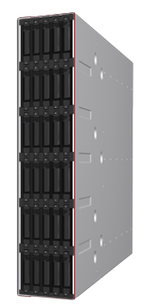
Mainframe Storage – DS8886 w/Easy Tier, Hyper-PAV and zHPF (High Performance FICON)
TPF Environments – High Performance Flash Enclosure
A.K.A Bluehawk – required (risk if not done)
Up to 12 TB raw flash capacity per enclosure
400GB x 30 Flash cards 1.8″ = 4 arrays
2-array version with 16 flash drives
Up to 4 Flash Enclosures/System
Up to 48 TB raw per system
Hybrid DS8886 system allows up to 120 Flash cards plus 1536 2.5″ HDDs
High-performance flash enclosure fits into existing DS8886 bay
Field MES available for DS8886 at GA
Configuration
Small environments – all BlueHawk
Large environments – combination of BlueHawk and 300GB 15K using Easy Tier
Standard Configuration
All 600GB 10K using Easy Tier, Hyper-PAV and zHPF – RAID6
DS8884 can be used for smaller environments – 50TB or less approx.
Recommendation is to partner with STG in solutioning here. Super high Performance solutions may require SSDs w/RAID10.
All IBM Storage except XIV is now RAID6 and V5030 and V7000 are DRAID6

Slide 83
IBM Strategic Storage IBM All Flash
GTS Global Storage Strategy

Slide 84
IBM FlashSystems Guidance Designed to provide very low latency high-quantity IOPs
We have introduced a new Strategy in this document regarding Flash.
We are moving from a traditional SVC Spectrum Virtualized environment.
We have developed two new solution building blocks that are Flash centric.
All Flash using the IBM A9000 POD
Both of these new solutions allow us to provide outstanding optimization
Both of these options support Fiber Channel or iSCSI connections
Note: AIX does not support iSCSI
Price per GB is very competitive compared to the Gartner guide
Simplified less problematic more easily managed infrastructure

Slide 85
SVC Fronted A9000 Solution Guidance
General guidance: http://www.redbooks.ibm.com/abstracts/redp5408.html?Open&pdfbookmark
SVC 7.8.1 or higher firmware required
A9000 Gen2 POD unit (9836-425 / 9838-425) approved for use behind SVC (2145-DH8, SV1 Only)
Includes 3 controller units and 1 flash enclosure
The 3.6 TB, 8.5 TB, 18 TB sized flash modules are recommended due to space savings
Use an effective capacity ratio of 2.5:1 when calculating volume size allocations to the SVC cluster
If the savings ratio is greater than 2.5:1 and additional A9000 volumes will be created, then exception approval required by GTS
No SVC RTC (real time compression) allowed, due to A9000 compression be default
No SVC software based encryption allowed, encryption can be enabled at the A9000 layer
A patch MUST be applied to set aside physical capacity (300 GB default, use 600 GB per GTS), in case of the A9000’s physical capacity being overrun (proper monitoring prevents an out of capacity issue from occurring):
The patch installation can be completed remotely
TA opens a Watson ‘Apply Patch’ activity
TA schedules a planned date to apply the patch remotely through XRSC
Location of patch listed under PMS page (SvcOopNotifierV1.tar.gz) - https://wiki.xiv.ibm.com/display/XEST/PMS+for+Patch+Management+Utility
Instructions to apply via PMS - https://wiki.xiv.ibm.com/pages/viewpage.action?pageId=126574275
Details of the issue: http://www-01.ibm.com/support/docview.wss?uid=ssg1S1010564
Thick provisioning at the SVC level is supported
Thin provisioning at the SVC level is supported, only if the SVC pool/mdiskgroup for the A9000 is not over-subscribed (virtual capacity not allowed to be larger than pool/mdiskgroup capacity) – GTS preferred
Allows consumption based billing to continue to occur at the SVC level, and not after the A9000 space savings
SVC mdisks (backend volumes) from A9000 should be set to the following via “chmdisk” command: (Flash only Pool)
Tier = “ssd”
Easytierload = “very_high”
IBM Internal Use

Slide 86
SVC Fronted A9000 Solution Guidance (cont.)
A9000 VOLUME GUIDANCE
Assumption: 2 out of 4 FC ports will be zoned to the SVC cluster, from each of the three controllers (6 x FC ports total)
Create 24* volumes on the A9000 to be presented to the SVC cluster
Calculate decimal size of volumes (assume only 90% of effective capacity can be allocated):
(physical capacity) * (savings ratio) * (90%) / (number of volumes)
Volume size for 3.6 TB unit:
((36 TB) * (2.5) * (0.90)) / (24) = 3.375 TB
Volume size for 8.5 TB unit:
((85 TB) * (2.5) * (0.90)) / (24) = 7.96 TB
Volume Size for 18.0 TB unit:
((180 TB) * (2.5) *(0.90)) / (24) = 11.25 TB
Note: * GTS IS has deviated from guidance provided from REDP5408 to meet Q value for Mdisk on Spectrum Virtualize Controller
IBM Internal Use

Slide 87
IBM FlashSystem A9000 / A9000R HyperSwap – HA Design
GTS Specific Best Practices:
Preferably Red Hat Enterprise Linux for Quorum Witness. Register using this link¹
Setup replication port zoning (a minimum of 2 as Initiators and 2 as Targets on each A9K) per guidance.
Use a dedicated VM for Hyper-Scale Manager
Copy Quorum Witness Certificate into HSM to register A9Ks.
Ensure A9K’s and Quorum Witness are on a different routable network/subnet to each other.
Install Host Attachment Kit (HAK) 2.9 or later for Flash A9K on Client Host. Map HyperSwap Volume from both A9K’s. Client Host uses Active/Preferred Path(s) from Primary A9K.
Use default ‘multipath.conf’ file, created by HAK.
Test automatic fail-over and manual fail-back before placing in Production Use for new builds.
If VMware follow this kb https://kb.vmware.com/s/article/2151070
Ensure a Pre-Go Live checklist is completed by a GTS Architect for new builds.
Recommended Configuration
Storage High Availability solution (HyperSwap) A9K/R
Please follow this Redbook where appropriate https://www.redbooks.ibm.com/redpapers/pdfs/redp5434.pdf
Establish Local Site Mirroring between A9K units.
Ensure a Dedicated Virtual Machine (which isn’t dependent on the SAN) is used for the Quorum Witness
*** See Best Practices Community for additional guidance ***
IBM Internal Use
Notes:
Note1: Internal URL given to register with your IBM Email ID and register RHEL Server to receive latest packages

Slide 88
IBM Strategic Storage SVC Detail
GTS Global Storage Strategy

Slide 89
Storwize Virtualization (SVC) – SV1 model
SAN Volume Controller is now an exception basis only. See slide 31 for details.
For smaller environments (like remote office, etc), we are approving using Storwize V5030 or V7000 gen2+ without external SVC nodes. Real Time Compression with v7000 gen2+ only. It does not allow virtualizing other DISK subsystems behind the Storwize. 100TB or smaller envs (total size) for v5030, 200 TB for v7000 gen2+
SV1 nodes require one compression assist cards and three FC cards. See our global best practices for port layout. For envs using extensive RTC, use dual compression assist cards.
Recommendation is to include a spare node for new clusters. See spare node best practices.
As for what data can and cannot go behind SVC, SVC is no longer strategic. There are special cases where very I/O intensive data that requires sub 2ms response time for all IOs may be excluded from SVC and dedicated to very specific technology to ensure isolation for those applications. This is rare but does occasionally occur. DISK Magic and performance studies should be done before any data is relocated to SVC/IBM Storage solutions.
Expectation for SV1 is 200k IOPs per IOGRP. 1.5PB of usable capacity allowed behind 8 node cluster. In order to exceed, you need a month of performance data to understand your peak loads. You can go higher if performance reporting shows acceptable performance below max. Spectrum Control (TPC) 5.1 or higher required for all SVC deployments.
See SVC Best practices to ensure you deploy logically and physically correctly. PGL process required.
VMAX Guidance. General recommendation is to not use VMAX behind SVC with CG8s. It is suitable as a conversion mechanism to IBM (image mode for conversion only). We however do support VMAX behind DH8 and SV1 SVC nodes. Strategy allows for VMAX FAST use but not Thin or SRDF; Thin and replication will be run at SVC level. You do need TPC with this and back-end limit LUN size of 2TB.

Slide 90
Storwize Virtualization (SVC) – Spare Node Requirement
GTS position and strategy:
All new SVC cluster orders with high availability agreements/requirements should include spare a node (SV1) at each site
We strongly recommend customer with 2 and 4 node SVC environments to purchase a spare node for seamless redundancy in the event of an extend node outage
Customers with 6 nodes or greater are required to have a spare node
Customers with high SLA requirements defining seamless operation and redundancy are required to have a spare node
Additional cost will be associated to this new design, or RFS on existing (HA)
Reason for GTS Position and strategy:
The intention is to have a spare SVC node sitting on the SAN ready to be swapped in to a cluster should a node fail for any reason.
Link to Best Practice Policy:
go to link: ibm.biz/globalsvcbp
Notes:
© Copyright IBM Corporation 2018
90
July 17, 2018
© Copyright IBM Corporation 2018
90
July 17, 2018

Slide 91
Spectrum Virtualize – High Availability capabilities IBM HyperSwap & IBM Stretch Cluster
HyperSwap – Use for HA solutions where 3rd distant DR site not required
HyperSwap adds application awareness
Group together multiple volumes to ensure application-wide failover
Ensures at least one site has latest copy of all volumes in group
HyperSwap caches in 2 IO groups
If one site is unavailable, the remaining site has a full IO group with caching available
No drop in performance in a disaster
HyperSwap retains old consistent data during resynchronization
Allows sites to continually provide disaster recover protection through lifecycle
Stretch Cluster – Use for HA solutions where 3rd distant DR site is required
Stretch Cluster adds application awareness
Group together multiple volumes to ensure application-wide failover
Ensures at least one site has latest copy of all volumes in group
Allows for Active Active across both locations (MetroMirror distance restrictions in play)
Stretch Cluster Provides DR site (Third site Replication)
As the Metro Mirror like function Active Active allows for synchronous data replication it also allows for a third location asynchronous replication to a DR location. No drop in performance in a disaster
Stretch Cluster retains old consistent data during resynchronization
Allows sites to continually provide disaster recover protection through lifecycle
***** Encourage clients to leverage High Availability Solutions where required*****

Slide 92
SVC Compression (RTC) use for new deals - requirements
SV1s with dual compression cards are go forward strategy (If using the SVC is mandatory, see slide 31 for valid SVC deployments)
DH8 allowed for older clusters provided 2nd CPU and compression cards
Must be running R7.5 target level or above w/RTC licenses.
A volume can be compressed and thin provided you are at target code level
Only compress very compressible volumes. 40% demark is guidance (and above).
512 LUN limit per IOGRP (2048 LUN limit per 8 node cluster)
Solutioning assumption: 80% compression ratio across 30% of SVC environment
Focus should be on databases. Sequential should be avoided. See best practices
This yields a 24% storage reduction
Labor
5% uplift for year one for storage admin support (would cover both thin and compression if you did both)
.5 addl server admin for duration of compression deployment (for compression assessment) band 7 (GR)
Labor sizing still remains on usable capacity (with compression enabled, a lesser amount)
Labor for backup and network needs to be based on uncompressed data size
Migration to SVC and new solution needs to be sized and staffed per standard process and uncompressed size.
Storage Senior Storage SME staffing included per FWB ratios.
Performance/Capacity management staffing included per FWB ratios.
Spectrum Control (TPC) 5.2 or higher required
SVC CPU utilization reporting and SNMP alerting deployed
Pool utilization as well as compression is a form of thin (over-subscribing)
Each deal should include $10K for delivery education (until further notice)
Rapid hardware ordering process. Delays for new storage cannot occur. DPE/PE approves ahead of use.
Use Redbook → http://www.redbooks.ibm.com/abstracts/redp4859.html?Open
Cookbook → https://w3-03.ibm.com/tools/cm/iram/oslc/assets/BFCD523F-57B5-F729-9864-FD43CAA4E005/1.0
Do not use for TIER0

Slide 93
SVC Thin Provisioning use for new deals - requirements
Must follow our defined best practices if you are to use.
Must maintain a minimum of 10% available storage in environment at all times – Cognos report R001_Cap from Reporting Table.xlsx @ http://ibm.biz/BdRUR7 Applicable to TPC 5.1 and TPC 5.2
Report description https://www-01.ibm.com/support/knowledgecenter/SSNE44_5.2.6/com.ibm.tpc_V526.doc/fqz0_r_cr_storage_systems_space_rpt.html
Must have SNMP threshold alerting to SYSOPs TPC 5.2 or higher supports alerting when available pool capacity is too low from within the TPC Web GUI
Hardware ordering process starts when 20% available space threshold hit. Use R001_Cap TPC Cognos report to monitor available space
Rapid hardware ordering process required. Delays for new storage cannot occur. DPE/PE approves ahead of use.
Solutioning assumption: 20% thin across 70% of environment
See subsequent page for calculation on savings (combined with compression)
Labor
5% uplift for year one for storage admin support (would cover both Thin and Compression if you did both)
.5 additional server admin for 6 months (for thin reclamation)
Labor sizing still remains on usable capacity (with thin enabled, a lesser amount)
Labor for backup and network needs to be based on actual data size
Migration to SVC and new solution needs to be sized and staffed per standard process. SVC Thin is a go forward strategy (we do not support thick to thin migrations). Only exception here is for IILM accounts where it can be automated.
Storage Senior Storage SME staffing included per FWB ratios.
Performance/Capacity management staffing included per FWB ratios.
TPC SE 5.1 or higher required. Recommend TPC 5.2.x See following links
Link to GSAR best practices -> Notes://D01DB034/85256FAC0019FBDC/F499A794F73637A885256FA50066975B/5CFA4874A408D270852577A10063B652
Cookbook -> https://w3-03.ibm.com/tools/cm/iram/assetDetail/generalDetails.faces?v=2.0&guid=8D2F9183-1615-CFD6-12BB-4AE3022A683D
Strategy is to do 100% thin.
93

Slide 94
Calculation for ‘solutioning’/savings with Compression and Thin
An example of Compression and Thin savings when applied to a 1PB solution
General formula assumptions for Thin and Compression
We can achieve 80% compression across 30% of environment
We can achieve 20% thin over-subscription across 70% of environment
Based on this, we expect to be able to run
30% of the environment as fully allocated
40% of the environment as thin provisioned
30% of the environment as thin and compressed
We anticipate that about 20% of the volumes which are compressed or thin provisioned will be zeros. The capacity storing these zeros can be reclaimed by both the thin provisioned volumes and the compressed volumes
We anticipate that by carefully selecting the correct volumes to compress - we will be able to achieve 80% compression savings on the compressed volumes.
Overall the savings with a 1 PB environment will look like this:
300TB of fully allocated space on disk (no thin or compression)
400TB * 80% = 320TB of Thin provisioned space on disk
300TB * 80% * 20% = 48TB of Thin/Compressed space on disk
This gives a total disk capacity of 668TB. This is a savings of 33% when applying both Thin and Compression per our defined strategy.
If a client is already using one of these technologies, then savings need to be altered. For example, if a client is already doing thin w/over-subscription, then you need to do that and cannot claim savings due to its use.
Notes:
As you perform these steps, you may find that you need to go back to prior steps if you don't get to the root cause initially.

Slide 95
Requirements needed to achieve savings For Compression and Thin
Compression
Compression is only used for data virtualized behind SVC and stand alone v7000 gen2+ with compression cards. Later slides explain that compression can also be used on A9K/XIV (when the data is NOT presented to SVC)
Baselines are only adjusted as data is virtualized behind SVC
Labor is based on usable capacity. Day 1 you are not achieving any reduction
Assumes no host or SAN based encryption
Assumes any database compression programs stops immediately
Assumes we are allowed to compress any data we deem compressible
Assumes all pre-reqs for compression in strategy deck are met
Assumes all pre-reqs for SVC in strategy deck are met (i.e. TB Iogroup limits).
Thin Provisioning
The client is not already doing Thin Provisioning w/oversubscription
Thin is only used for data virtualized behind SVC and v7000 gen2+
Baselines are only adjusted as data is virtualized behind SVC
Labor is based on usable capacity. Day 1 you are not achieving any reduction
Assumes we are allowed to apply Thin w/oversubscription any data we deem worthy
Assumes all pre-reqs for Thin Provisioning in strategy deck are met
We use automated compression and thin via Intelligent ILM. Client must approve ahead of deal signing.
Notes:
95

Slide 96
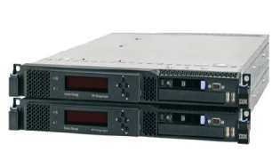
Easy Tier Functionality Required for all DS8K deployments
Easy Tier is a DS8K, SVC, and Storwize (v5030/v7000) built-in dynamic relocation feature that allows a host transparent movement of data among the storage system resources.
This feature significantly improves configuration flexibility, manageable performance tuning / planning, and improves storage efficiency, by better utilizing disk capacity.
Effectively, this software will enable a tiered environment to match the cost of storage to the value of data.
Since SVC and Storwize add additional cache, it can improve the performance of lower tiered disk, for significant cost savings
Easy Tier is free with DS8884/DS8886
Easy Tier is free SVC or Storwize on R6.1 code or higher.
DS8884/DS8886 Support three tier and automatic LUN rebalance (ability to remove hotspots).
It is currently recommended to use SVC Easy Tier due to Thin Provisioning and/or Compression requirements.

Slide 97
Tiered Storage Mapping (one tech to another)
Source Storage unit | Available Storage | Considerations | Recommendations
Any unit with SSD | DS8 with HPFE for Z. Distributed A9000 | The amount of total storage needed. If under 50TBs useable, a DS8884. If above 50TBs useable, a DS8886. | Use DISK Magic for mass consolidations
DS8100/DS8300 | DS8884/DS8886 (Z only) Distributed A9000 | The amount of total storage needed. If under 50TBs useable, a DS8884. If above 50TBs useable, a DS8886. | Use DISK Magic for mass consolidations
SHARK | Any TIER1 block. A9000 is a suitable replacement. See other considerations and recommendations. | The amount of SHARKs to be consolidated. You can consolidate more onto DS8s than you can onto XIVs | Use DISK Magic for mass consolidations.
EMC DMX1000, DMX2000, DMX3000 using FC drives | Any TIER1 block. A9000 is a suitable replacement. See other considerations and recommendations. | The amount of units to be consolidated. | Use DISK Magic for mass consolidations.
EMC DMX3, DMX4, VMAX using RAID10 and FC | DS8886 (Z Only). FS/DH8/SVC/A9000 | If SSD and FAST in use, ensure DS8 has SSD and plans for Easy Tier | Use DISK Magic for mass consolidations
Clariion with FC drives | A9000 can be used. TIER2 V5030 or v7000 gen2+ might be a more suitable choice. |  | Use DISK Magic for mass consolidations.
Any unit with SATA | Preferably v5k w/NL-SAS | The amount and combination of storage. If you have between 200TB and 600TBs of useable strg in total, a DS8 with both TIER1/2/3 storage in it might be a more suitable route. Another option is a V5030 with SATA. | Use DISK Magic for mass consolidations
Hitachi AMS 200 family with FC drives | A9000 can be used. TIER3 V5030 might be a more suitable choice. |  | Use DISK Magic for mass consolidations.
Hitachi VSP with FC drives | DS8886 (Z Only). FS/DH8/SVC/A9000 | The amount of total storage needed. If under 200TBs useable, a DS8700. If above 200TBs useable, a DS8870. | Use DISK Magic for mass consolidations
Hitachi USP V / USP VM with FC drives | DS8886 (Z Only). FS/DH8/SVC/A9000 | The amount of units to be consolidated. | Use DISK Magic for mass consolidations

Slide 98
Easy Tier Guidance
Our strategy is to use Easy Tier at SVC layer. If DS8 or Storwize are enabled, you should convert to SVC ET.
If DS8 ET is in use behind a SVC, be sure you disable before moving to SVC code version 7.3.x (or higher). With this version SVC ET is automatically enabled (rebalance).
If no SVC in mix, it is recommended to use native Easy Tier functionality.
We encourage use of SVC ET w/Flashsystem
Even when just one type of disk in given SVC MDISKGRP our best practices are to use (once at 7.3.x or higher).
The minimum SVC extent size is 256 MB with 512 MB preferred
Best practices guidance…
http://w3-03.ibm.com/support/techdocs/atsmastr.nsf/WebIndex/WP102295
http://www-03.ibm.com/support/techdocs/atsmastr.nsf/WebIndex/WP101844
http://www-03.ibm.com/systems/storage/software/virtualization/svc/
http://www.redbooks.ibm.com/abstracts/sg248886.html
http://w3.itso.ibm.com/abstracts/sg247933.html?Open
http://w3-03.ibm.com/support/techdocs/atsmastr.nsf/WebIndex/PRS4703?Open
http://w3.itso.ibm.com/abstracts/redp4667.html?Open

Slide 99
DRAID, RAID6, RAID5
What is DRAID
Distributed RAID was launched in 7.6.0 and allows a RAID5 or RAID6 array to be distributed over a larger set of drives. Previously if you created a RADI5 array over 8 drives, the data was striped across them with each stripe having a data strip on 7 of the drives and a parity strip on the 8th. In distributed RAID5 you specify the stripe width and the number of drives separately so you can still have 7 data strips protected by a parity strip but those 8 drives are selected from 64. On top of that we added distributed sparing, this is the idea that instead of having a spare sat on the side that isn't being used, each drive in the array gives up some of its capacity to make a spare.
Rebuild Performance
The main reason for distributed RAID is to improve rebuild performance. When a drive fails, the data from that drive has to be rebuilt from the surviving drives and written to a spare. By having a larger set of drives in the array those rebuild reads are coming from more drives and distributed sparing means the writes are going to a larger set of drives. Reading from a small set of drives and writing to a single drive is what causes rebuilds to take a long time in traditional RAID, especially if the drive you are writing to is a 4TB nearline drive. When I say a long time, I mean over 24 hours. With RAID5 a second drive failure during a rebuild means the array goes offline and if the drive can't be resuscitated the entire array needs to be restored from backup, RAID6 copes with a second concurrent failure but a third is going to be terminal. Some products offer RAID7 to cope with 3 failures, but it is all just delaying the inevitable as the drives get bigger and rebuilds take longer.

Slide 100
Deduplication Strategy and Best Practices
We have dropped ProtecTIER gateway and EMC Data Domain appliance VTLs from our strategy, this to lead with Spectrum Protect v8 in all new deals and engagements. Note: ProtecTIER goes EOS in Nov 2020 and EOM effective 2Q 2018.
Main reasons for leading with Spectrum Protect over appliance VTLs are gives 3x lower TCO (a conservative approach) AND:
No additional software license cost, a simpler Delivery and Solution model (using one product instead of many is less complex both in solution, steady state and maintenance).
Spectrum Protect v7.1.3 software changed from post process to in-line dedup, I/O only for needed data (de-duplicated chunks), new container storage pool avoids costly background processing (reclamation, 'garbage collection’ for deletion)
v7.1.5 added in-line compression allowing container pools to be on same level as VTLs when it comes to total data reduction.
In-line dedup allowing us to use very large low cost disk drives for the backup storage pool, currently 8TB.
V8.1.3 added tiering to Cloud Object Storage (reduced cost for non RTO sensitive data)
If you cannot lead with Spectrum Protect lead with ProtecTIER as the first choice in GTS Resiliency Service Line strategy. Engage Lab Services IBM trained sizing expert required for ProtecTIER planning and deployment if skills does not exist in team. Only use Data Domain if it is hard written in the contract that Data Domain is a demand.
Tip: Know the ‘expiration dates’ for dedup appliances in your accounts for reducing TCO.
We use ProtecTIER VTLs when:
10Gbit LAN or more does not exist in-house and LAN-Free backups are desired.
A copy pool using tape is a requirement and container storage pools to tape does not meet the copy to tape restore performance requirements.
Existing ProtecTIER or Data Domain account might not want to move to Spectrum Protect in-line dedup until the end of a contract (HW investments already made), unless there is a business case for it.
VTL to physical LTO tape migration is okay. Note: We have the ability to make a backup of a container storage pool to tape in v7.1.7 (protect storage pool to local). Additional deduplication guidance in next slide and in links below:
https://ibm.biz/BdX3xd
https://www.ibm.com/developerworks/community/wikis/home?lang=en#!/wiki/Tivoli%20Storage%20Manager/page/Directory-container%20storage%20pools%20FAQs
https://www.ibm.com/developerworks/community/wikis/home?lang=en#!/wiki/Tivoli%20Storage%20Manager/page/Cloud-container%20storage%20pools%20FAQs/
Spectrum Protect Deduplication internal blog: The Economics of Large Scale Data Protection

Slide 101
Deduplication Strategy and Best Practices
We have dropped ProtecTIER gateway and EMC Data Domain appliance VTLs from our strategy Q4 2016, this to lead with Spectrum Protect in all new deals and engagements.
Main reasons for leading with Spectrum Protect over appliance VTLs are gives 3x lower TCO (a conservative approach) AND:
No additional software license cost, a simpler Delivery and Solution model (using one product instead of many is less complex both in solution, steady state and maintenance).
No need to involve professional services as we need with VTL deployment, maintenance, code update, design change etc.
v7.1.3 software changed from post process to in-line dedup, I/O only for needed data (de-duplicated chunks), new container storage pool avoids costly background processing (reclamation, 'garbage collection’ for deletion)
v7.1.5 added in-line compression allowing container pools to be on same level as VTLs when it comes to total data reduction.
In-line dedup allowing us to use very large low cost disk drives for the backup storage pool, currently 8TB.
V8.1.3 added tiering to Cloud Object Storage (reduced cost for non RTO sensitive data / long term retention data)
For existing ProtecTIER and EMC Data Domain deployments: Note: ProtecTIER goes EOS in Nov 2020 and EOM effective 2Q 2018
Know the ‘expiration dates’ for the ProtecTIER EMC Data Domain VTLs appliances in your accounts for reducing TCO.
Existing ProtecTIER or Data Domain account might not want to move to Spectrum Protect in-line dedup until the end of a contract (HW investments already made), unless there is time for hardware refresh or next expensive hardware maintenance
VTL to physical LTO tape migration is okay. Note: We have the ability to make a backup of a container storage pool to tape from v7.1.7 (protect storage pool to local). Additional deduplication guidance in next slide and in links below:
https://ibm.biz/BdZinW
https://ibm.biz/BdZiec
https://ibm.biz/Bdjh2z
Spectrum Protect Deduplication internal blog: The Economics of Large Scale Data Protection

Slide 102
Integrated Systems and Storage (PureSystems)
This is for Pure Systems Product Lines (PureFlex and PureApplications) ONLY.
Tier 1 Storage is External to Integrated System ONLY and applies to PureFlex ONLY.
Tier 1 Storage requires Upgrade to 16Gb SAN Switch Modules and applies to PureFlex ONLY
Storage with a connectivity rate no less than 8Gb per port is recommended.
V7000 Integrated is internal connectivity to SAN Switch Modules and due to design flaw does not have as much bandwidth as a standalone (in Flex Rack or external to Flex Rack) model. Not recommended due to thru-put limitations.
Replication is currently functional and managed entirely from the Storage interface.
EasyTier is fully supported in the PureApplication Product Line.
EasyTier is partially supported with PureFlex (may use but no integrated function.)
Any connection to Brocade 8Gb Platforms (Condor2/DCX) requires port fill word 3 be set, regardless of the speed the ports are running at. Failure to do so will result in SAN outages.
VMControl Auto Storage Provisioning Requires Full Fabric Zoning Mode for SAN Switch Modules.
Top of rack switches cannot be used to direct connect ‘external’ SVC nodes and/or disk. These should be treated as Edge and connected to Core when needed. Exception based review when needed.

Slide 103
GTS Hardware Snapshots and Data Re-use Strategy
Two types of snapshots are supported, application consistent-application aware snapshots and crash consistent power failure snapshots.
Application consistent, application aware snapshots. We can do RTO in <5 min and RPO in <60 min, lead with hardware snapshots and Spectrum Protect Snapshot (old name was FCM). RPO needs to be planned depending on application requirements. More guidance in Tiered Data Protection & Recovery Tiered Classification page.
Crash consistent power failure snapshots provides higher RTO since data are not application consistent, remember that there is a high risk for a need for file system checks during boot/mount and for database crash recovery restart which all leads to a higher RTO.
Multi-tenancy on the storage devices where storage pools can be partitioned and separate credentials can be defined for admin access to those storage pools, Spectrum Virtualize requires a TCP/IP connection from Spectrum Protect Snapshot server in order to manage the FlashCopy operations. The Spectrum Protect Snapshot user ID used by Spectrum Protect Snapshot needs to have admin rights and those are not limited to FlashCopy operations. Remember that Spectrum Virtualize does not support multi-tenant. For security reasons this means that dedicated Spectrum Virtualize clusters are required for application consistent, application aware storage hardware based snapshots.
Current GTS strategy:
Dedicated environment - use hardware snapshots on supported e.g. Spectrum Virtualize and XIV hardware
Shared environment (multi-tenancy) - use Spectrum Protect Snapshot (FCM) + XIV 11.6 (same on DS8000 since they also put multi-tenancy in)
Dedicated Spectrum Virtualize clusters for accounts that requires application consistent, application aware storage hardware based snapshots
Do not run hardware snapshots more often than every 60 min if required (this is for both dedicated and multi-tenancy environments)
Future GTS strategy:
We are validating Spectrum Protect Plus, Spectrum Copy Data Management (former Catalogic), Actifio, Cohesity, Rubrik and Cirrus. Plus validation link https://ibm.biz/BdZcu5
Tip. Spectrum Virtualize Metro and Global Mirrored environments simplified storage management through automatic provisioning of FlashCopy target volumes.

Slide 104
Tiered Data Protection and Recovery Classification
RPO / RTO and technologies to achieve that. RPO/RTO MUST be agreed with the Client
TIER | Description | Technical Examples – High level Guidance – Local variations on technology exist
 |  | RPO/RTO | Technologies/Methodologies (non DR) | Techniques/Methodologies (DR) | Notes
Spectrum Protect HA solutions | Spectrum Protect server High availability provides ability to restore from alternative source. RESTORE RPO/RTO will still depend on backup/restore methodology below. | See below and in notes section for more detailed guidance | See below. Replication should not affect backup/restore method except where volume to replicate might be an issue. Replication could apply to ALL Tiers. | Replication of backups between sites - Spectrum Protect Node Replication + Protect Stg If not using Spectrum Protect Node Replication, consider Cluster solutions i.e. PowerHA Straight Global or Metro mirroring replication | - Replicates backup data between sites allows restore of data from secondary Spectrum Protect server auto if primary is unavailable – depends on timing whether data has replicated. No need to fail over to secondary Spectrum Protect server. Does not provide an alternative target Spectrum Protect server for BACKUP and two-way replication but from V7.1.7 able to recover damaged files from target back to source. - Dissimilar policy can be leveraged to reduce cost of DR copies by storing less data on DR side than on primary side and reverse.
TIER1 Rapid recovery solution | Hardware Snapshot-based Spectrum Protect Snapshot Spectrum Copy Data Management | RTO minutes - <5 min RPO minutes - <60 min | Spectrum Protect with Spectrum Protect Snapshot LAN-Free backups to ATL if no 10GbE exists. | f no 10GbE exists, consider ATL Replication. It would only be sensible to do this if there are servers available at the DR site onto which data can be quickly restored. Note that using Test/Dev servers for this is more complex to test because they need to be backed up before a test and restored after. | RPO of minutes would need logs to be offloaded constantly somehow. Need to consider the FlashCopy frequency. Snapshot-based backups: RPO requirements map directly to the frequency of the Snapshots and this in turn points to the disk technology. Spectrum Virtualize support 256 concurrent snapshots for now. XIV many more. Also, how many versions are kept on disk and how many copies sent to Spectrum Protect tape media. Consider using space efficient snapshots but they will re-hydrate when migrated/copied to tape. Need to consider space requirements and monitoring the capacity is important, like any thin provisioned solution. Spectrum Protect High Availability solution is suggested to support RTO TIER1 solution requirement.
TIER2 Medium RTO requirements | 10Gbit or teamed 1Gbit LAN LAN-Free Backup/Restore Spectrum Protect File-based restore TDP Application Restore Tape Based | RTO <4-12h RPO <4-24h | Spectrum Protect Incremental Forever Spectrum Protect - VE TDP Application Integration Image/Special Cases | Offsite Tape on the shelf | This covers Database/Application backups also OS/File-based backups. In the latter case backups would be done daily to achieve RPO can only be xx hours. Note LAN-Free restore throughput might be limited Restore performance depends on the volume of data to be restored and the resources (disk performance, tape drives & HBAs) available to do so LAN-Free is NOT a panacea for fast backups. Only helps with LARGE files. Consider high speed 10Gbit LAN first as cheaper and future proof.
TIER3 Low RTO requirements | Spectrum Protect File-based restore TDP Application Restore Tape ATL based | RTO 12-24h RPO up to 24h | Spectrum Protect Incremental Forever TDP Application Integration | Offsite ATL Tape library
TIER4 Long term retention | Object Storage or ATL Tape based, long term retention media, unstructured data | RPO – Point in Time RTO – Depends on Volume of data | Long term retenention separate nodes | Spectrum Protect Archive Separate Spectrum Protect Node for Monthly/Yearly Geo-Dispersed | See Cloud Object Storage decision tree for guidance.
COST / PERFORMANCE / AVAILABILITY
TIER rating is based on Recovery Time/Point Objectives
Notes:
104
This TIER guidance should be used in conjunction with the restore requirements for a customer. There is no ”rate” information in the table because, even within a TIER, it should be possible to scale the solution up – e.g. multiple restore sessions from multiple tape drives or disks – to achieve the desired RTO requirement. We might be able to look at adding some ”single session” guidance in the future but this is not available at the moment as it depends on so many variables.
There is no point in implementing a backup schedule without first understanding, documenting and agreeing the requirements for restores. Three things to consider:
Under what circumstances might you need to restore data – Full DB corruption, partial DB corruption, disk failure (usually multiple drives), virus, hacking event, accidental data deletion etc.
For each of these scenarios, how quickly would you need to be able to restore and then recover the service? Note that it may be practical to recover a service by failing over in less than 1 hour but you are unlikely to be able to restore a multi-TB database in the same time without significant investment.
To what point would you need to recover/restore? Put another way, how much data is the business prepared to lose in each of the circumstances above? Answering these questions will help define the frequency of backups, particularly of DB redo logs.
All of the above needs to be mutually agreed between a supplier and a customer. If there is no agreement then the supplier risks implementing something which they think meets the customer’s business requirements but which actually does not meet their expectations.
A secondary issue is that many services change over time. Business requirements change and a service which is not important today can become vital tomorrow. Regular review and re-validation by both parties of the requirements would allow such changes to be captured and, if necessary, backup methodologies to be changed to meet any new restore requirements.
Once the restore requirements have been agreed then you can decide which methodology/TIER might be appropriate to back up data in a way that facilitates the restore requirement.
Note that these slides currently only cover distributed environments and do not include zSeries or iSeries. The former probably requires a whole set of slides on it’s own and Best Practice for the latter is currently to use BRMS.

Slide 105
Other Data Protection and Recovery Areas
Area | Tools | Strategy Examples – High level Guidance – Local variations on technology exist
 |  | Capabilities | Notes
Migrations and T&T | Butterfly migration and AER | Migrate from v5 to v8, also from none IBM backup products to Spectrum Protect . Analytics on Storage and BaaS environment | Using Butterfly v5 to v8 upgrades and Storage discovery and analytics tooling, to migrate non-Spectrum Protect backup data to a Spectrum Protect archive object. Valuable in T&T projects. Migration can take time but no choice when archived data has to be moved.
Reporting AND Operational Management / Monitoring | Universal Storage Infrastructure Backup Reporting Service (USIBRS - Bocada) Spectrum Protect Operations Center also provides reporting. Management and Monitoring Spectrum Protect Operations Center ITM6 and ITM agents Do not forget Spectrum Protect Capacity and Performance management/Reporting. | Bocada (Reporting) Phoenix (Analytics) Spectrum Protect Reporting Tools included in Spectrum Protect Operations Center Capacity/Performance Management Alerting, Capacity, Health Checks Maintenance Datawarehouse Performance Management Automatic ticket generation Automatic client restart | The Resiliency Service Line strategic direction for backup and restore monitoring and reporting is the use of USIBRS which includes Bocada (Backup Status Reporting) and Phoenix (Server Health Check*). * Phoenix is undergoing further enhancements and until these are complete, Spectrum Protect Operations Center and NetBackup Operations Center must be deployed on all accounts until the enhancements are complete. If an account does not approve sending meta data to other countries, use local Bocada install.
Deduplication | Spectrum Protect server/client dedup | Removal of redundant data (Only applies to data in Spectrum Protect DISK Storage Pools – Migration to tape will re-hydrate the data) | See latest dedup guidance
Hypervisor data protection | Spectrum Protect -VE, Spectrum Protect Snapshot for VMware | Instant restore and agent less
Spectrum Protect Server Sizing | Spectrum Protect Blueprints | Provide guidance for sizing | Blueprints are covering xLinux, Windows and AIX platforms, note that we lead with Storwize v5030 model over ESS for lowest TCO http://ibm.biz/IBMSpectrumProtectBlueprints
Spectrum Protect OS platform | UNIX/Windows | Provide guidance of Spectrum Protect OS platform | GTS strategy is UNIX (AIX/RHEL).
Data Encryption | Security Key Lifecycle Manager (SKLM) | Encryption | Disk and Tape encryption to be deployed with SKLM as the IBM standard key manager for all disk, tape, and switch encryption implementations.
Spectrum Protect licence | PVU/Capacity End models | License model | Lead with capacity model Potential labor cost avoidance, potential reduction in license costs and increased software compliance posture.
Bare Metal Restore | Cristie TBMR | BMR primary for physical servers | Cristie TBMR
Notes:
105
This slide covers a number of other BaaS areas which should be considered. These may not directly affect the ability to back up or restore but relate to things like the currency of an environment, manageability, replication between sites, encryption etc.
Note that Butterfly have two components, Butterfly Analysis Engine Report (AER) have an automated software process which give complete visualisation of current customer environment (as a health check of the Spectrum Protect infrastructure) and for pre-sale to generate revenue and is designed to tackle the problem of historic data migration and vendor proprietary lock in.
It allows in depth comparison to target environment and delivers differential business case in easy to digest visual report. Butterfly fully automates actual data migration quickly, safely and without disruption to the production environment.
There is no downtime of the Spectrum Protect Server when using the migration tool, and eliminates inherent risk in manual data migration. Butterfly can be used not only for accessing old non-Spectrum Protect backups but also to analyze the existing environment and size the new TSM environment..
Also a migration tool from Spectrum Protect v5.5 to latest recommended level and migration from ISV to Spectrum Protect, in an automatic fashion and without any downtime for the backup & recovery service. The Butterfly AER includes a unique library containing efficiency and effectiveness statistics for various storage, server and infrastructure configurations. It provides a complete view of an organization’s existing data and infrastructure, presents the findings in an easily understood format that enables organizations to assess the cost and risk implications of staying with the current environment, and compares that to the proposed consolidated backup environment.
Contact persons on Butterfly are Mikael Lindstrom/Sweden/IBM and Jarl Theuwissen/France/IBM

Slide 106
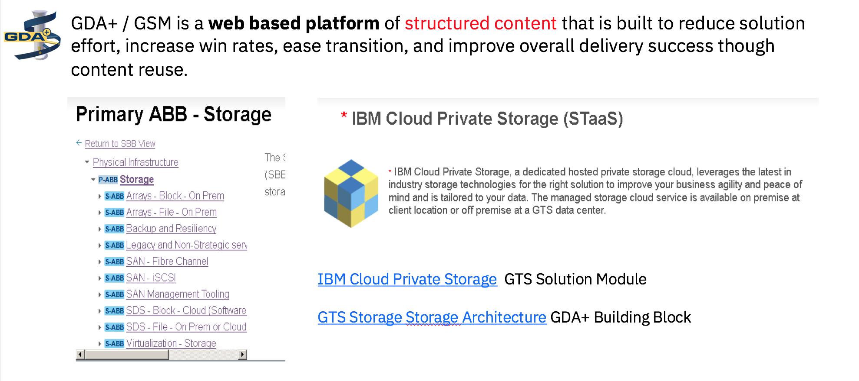
Global Delivery Architecture (GDA+) & GTS Solution Module (GSM)

